Slide 1

Understanding the mental health Crisis and what we can do about it
Mena Mirhom, MD
Light & Life 2018

Slide 2
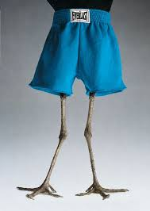
Why should I care about this?
STOP SKIPPING LEG DAY!
“If one member suffers, the whole body suffers.” 1 Cor 12
ITS ALL HEALTH

Slide 3
#MindsMAtter

Slide 4
Recap from last talk
1) Real, it’s actually a thing. (discussed what it looks like physically.)
2) Not always ‘spiritual’
3) Common (1 in 5 of us meet criteria, 5 of 5 could improve)
4) treatable! (emotional hygiene)

Slide 5

St. Mary & Stigma
Above the mainstream. Above the stigma
(Mark 6; ‘Is this not Mary’s son?’)
We need her intercession.

Slide 6


Slide 7
Do you know anyone who has…
Depression
Anxiety
Addiction
Suicidal thoughts

Slide 8
Where do people go first for help?
Work?
School?
Family doctor?
Mental health professional?
Emergency room?
Church?

Slide 9
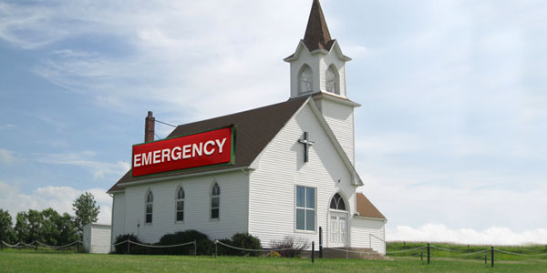
You. They go to you
Research shows that the first place people go is the church.
(Some call the servant before calling 911.)

Slide 10
So how do we treat this?

Slide 11
Survey says….
People with mental illness can overcome with prayer and bible reading ALONE.
?

Slide 12
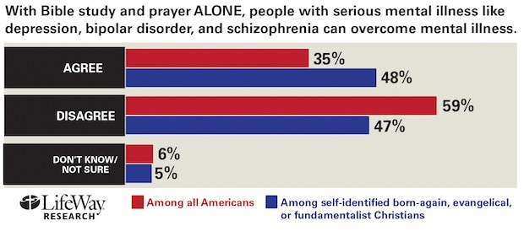

Slide 13
What do we ACTUALLY believe about treatment?
Bio-Psycho-Spiritual-Social
Bio- name that organ, hormone, neurotransmitter.
(Ex, thyroid.)
  Hypothyroidism- MDD
  Hyperthyroidism- GAD

Slide 14
Mental health myths: Medication is a sin or a weakness of my faith
Can God cure mental illness? / can God cure hunger?
“God is the source of all healing…Doctors just hog all the credit.” HGBM
“Still sick? Not praying enough.”– who said that?

Slide 15

God of Bentleys

Slide 16
Jesus, M.D.
Honor the physician with the honor due him, according to your need of him, for the Lord created him; ² for healing comes from the Most High, and he will receive a gift from the king.
⁴ The Lord created medicines from the earth, and a sensible man will not despise them.
⁶he gave skill to men that he might be glorified in his marvelous works.
Sirach 38

Slide 17

Abouna, Md
Coptic Mental Health Center, NJ

Slide 18
What’s being treated in the church

Slide 19
But did it WORK?! (only 84% of the time.)

Slide 20
Type of Functioning | Severe Impairment | Moderate Impairment | Mild Impairment | Average Functioning | Good Functioning | Superior Functioning
GAF Score | 0-50 | 51-64 | 65-74 | 75-84 | 85-94 | 95-100
Initially 99% of patients had mild to severe impairments, currently 76% of patients have average to superior functioning.

Slide 21
So what are these magical little pills anyway?

Slide 22
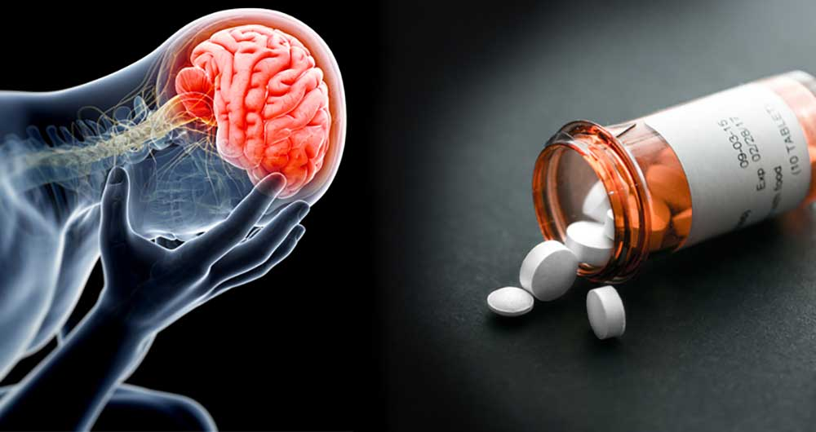

Traffic control
Antidepressants- Prozac, Zoloft,
Lexapro etc. (First approved by FDA, 1987)
  More SERATONIN please
Mood stabilizers (Lithium, Depakote)
Neuroleptics-
  Less DOPAMINE please

Slide 23
Risk of taking them vs
Risk of NOT taking them
Not taking them | Taking them
Untreated illness impacts your function (at home, at church, at work) | Side effects (MOST commonly mild, and there are lots of options.)

Slide 24
Medication myths
They’re addictive
I need to be on them forever
They change you
They’re dangerous

Slide 25
Maybe this would work for you too

Slide 26
Can really holy people struggle with this too?

Slide 27
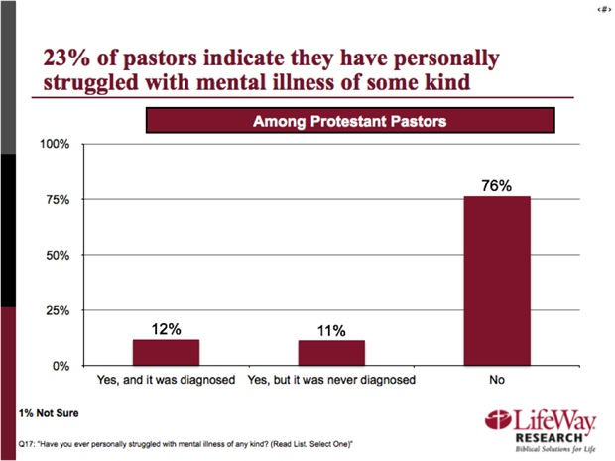

Slide 28
Mental health myths: holy people don’t deal with this
“Who sinned, this man or his parents?” (John 9 and the need to blame. GOTTA BLAME SOMEBODY!)
“Neither.”- Jesus

Slide 29
Spiritual problems or clinical disorder?
Depression & suicide vs despair
Anxiety disorder vs worry
Bipolar disorder
PTSD causes- persecution and trauma (“I cry every night.”)

Slide 30
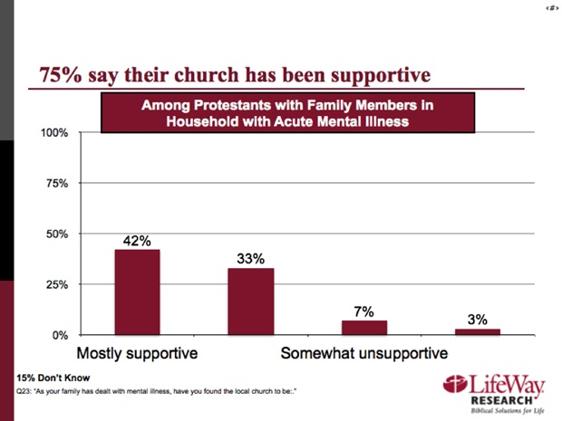
Is the church supportive?

Slide 31
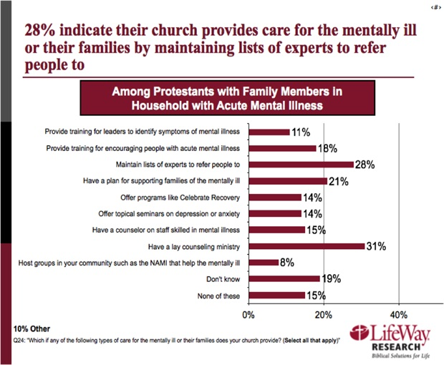
Is the church providing care?

Slide 32
Mental health myths: Addicts need to get better before coming to church
Addiction: sin or disease?
“Most assuredly, I say to you, whoever commits sin is a slave of sin. ³⁵ And a slave does not abide in the house forever, but a son abides forever. ³⁶ Therefore if the Son makes you free, you shall be free indeed – John 8:34

Slide 33
Mental health myths: there’s nothing you can do about this/There’s no treatment.
85% of individuals who have been prescribed medication for acute mental illness believe medication has been effective (that’s higher than the average.)
Treatment options: Medication, therapy, inpatient, outpatient, day programs etc

Slide 34
What do we do? At least, don’t make it worse
First do no harm
“You’re depressed? Just pray and read Philippians.?
Anxiety? Jesus said do not worry, so like…stop worrying.

Slide 35
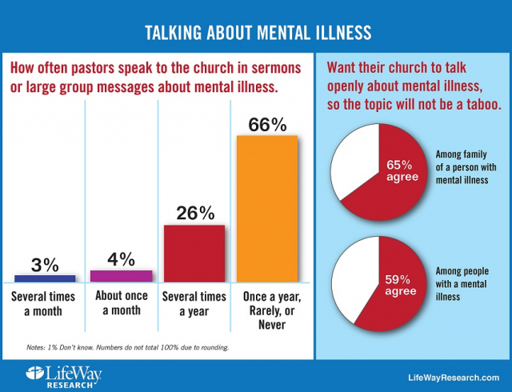
What do we do? 2) speak up/listen/learn
Awareness, education,
Decrease stigma.
Use youth meetings
Sermons, retreats
Don’t need to be an
Expert psychiatrist.

Slide 36
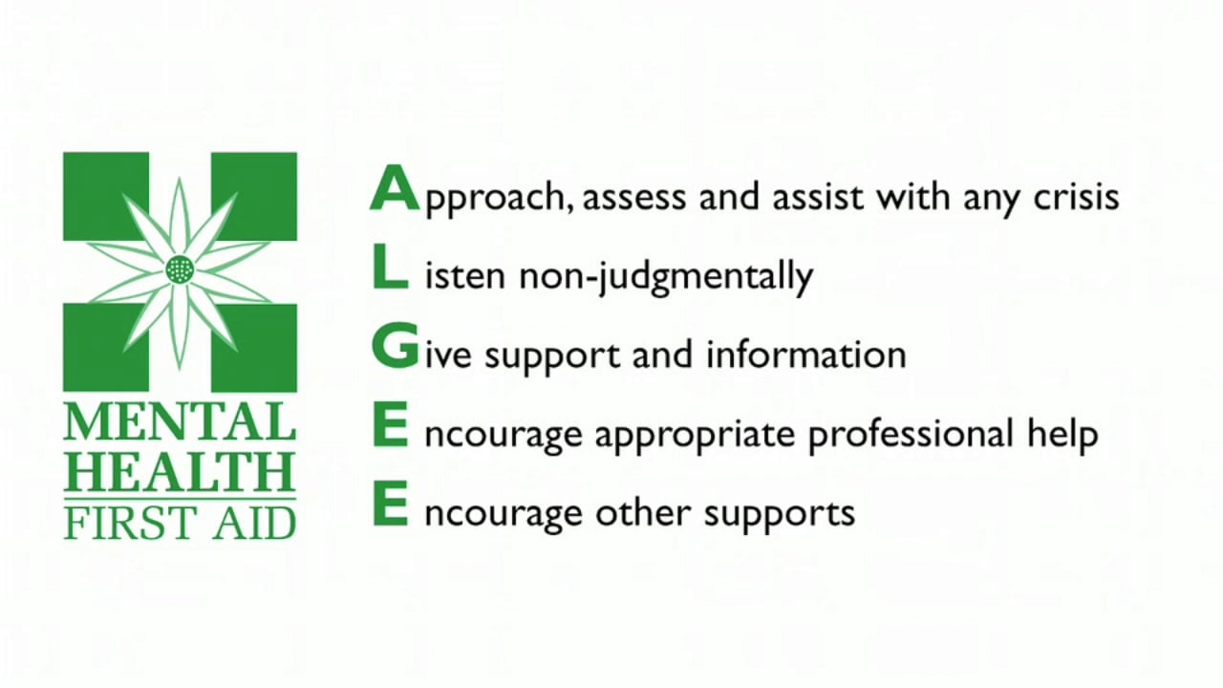
What do we do? Action plan.

Slide 37
FAQ: When do I Make a Referral to a Mental Health Professional?
Make a referral, not a diagnosis. ITS BETTER TO BE WRONG AND REFER TOO MANY PEOPLE.
THAT FIRST APPOINTMENT
Things to think about:
Danger – Is there danger to self or others, including thoughts of suicide or risky behavior?
Distress – How much distress, discomfort, or anguish is he/she feeling? How well is he/she able to tolerate, manage or cope?
Duty – Is he/she capable of caring for self? Able to problem solve and make decisions?

Slide 38
FAQs-What if I’m struggling with something that sounds like a mental illness?
HOPE4MentalHealth.com (find local provider)
primary care doctor.
St. Luke’s COPTIC Mental health clinic. (949)4ST-LUKE
National Suicide Prevention Lifeline, 1‑800‑273‑TALK (8255) or Live Online Chat

Slide 39
How do I talk with someone who is suicidal?
You can come to me and talk about suicide.” (use the word, doesn’t put ideas in their head)
Make the thought less isolating. Others have felt this….“Sometimes people feel overwhelmed and feel like life isn’t worth living…have you felt that way?”
“Have you ever thought of attempting suicide?” •
  “What can I do to help? We are in this together!

Slide 40
What should I do if my loved one is in a mental health crisis and is not willing to get help?
frustrating and scary – danger to self or others?
you can contact 911 and ask for a crisis intervention officer to be sent to the location.
Some people seem to be unaware of how mentally ill they are and therefore don’t recognize their need for medical treatment.

Slide 41
Contact. Questions?
MenaMirhom@gmail.com, 917-402-0564

Slide 42
TED depression
https://www.youtube.com/watch?v=z-IR48Mb3W0&feature=youtu.be

