Slide 1
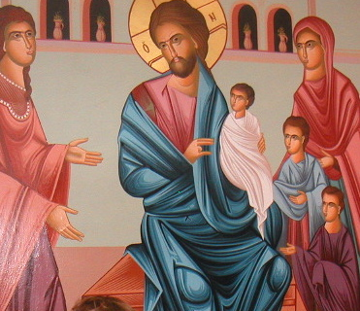
The Greatest ! When?
2nd Sunday of Abib

Slide 2
μείζων = G 3187 =Meizon
Mentioned 48 times in 42 verses in the New Testament
8 times arguments between the disciples

Slide 3
The Synoptic Gospels
Matt
17:1-13 transfiguration
17:14-21 the disciple could not cast out a demon
17:22-27 the Lord spoke about his death + paying the tax
18:1 who is the greatest
Mark
9:1-13 Transfiguration
9:14-21 The Disciple could not cast out a demon
30-33 the Lord spoke about His Death
9:34 who is the greatest
Luke
9:28-36 Transfiguration
9:37-43 the disciple could not cast out a demon
9:44-45 The Lord spoke about His Death
9:46-48 who is the greatest

Slide 4
After a failure

Slide 5
Matt 18:1-5
At that time the disciples came to Jesus, saying, “Who then is greatest in the kingdom of heaven?”2 Then Jesus called a little child to Him, set him in the midst of them, 3 and said, “Assuredly, I say to you, unless you are converted and become as little children, you will by no means enter the kingdom of heaven. 4 Therefore whoever humbles himself as this little child is the greatest in the kingdom of heaven. 5 Whoever receives one little child like this in My name receives Me.

Slide 6
St. John Saba
Put on humility all the time, to turn yourself into a dwelling place for God.

Slide 7
Mark 9:33-37
33 Then He came to Capernaum. And when He was in the house He asked them, “What was it you disputed among yourselves on the road?” 34 But they kept silent, for on the road they had disputed among themselves who would be the greatest. 35 And He sat down, called the twelve, and said to them, “If anyone desires to be first, he shall be last of all and servant of all.” 36 Then He took a little child and set him in the midst of them. And when He had taken him in His arms, He said to them, 37 “Whoever receives one of these little children in My name receives Me; and whoever receives Me, receives not Me but Him who sent Me.”

Slide 8
St. John Chrysostom
He exhorted them to acquire humility and simplicity, as demonstrated in a child, namely pure from jealousy, from vain glory, and from love of authority.

Slide 9
Luke 9:46-48
46 Then a dispute arose among them as to which of them would be greatest. 47 And Jesus, perceiving the thought of their heart, took a little child and set him by Him, 48 and said to them, “Whoever receives this little child in My name receives Me; and whoever receives Me receives Him who sent Me. For he who is least among you all will be great.”

Slide 10
Fr. Theophlactius
He wants us, not to take over (earthly) supremacy for ourselves, but to reach up for it the heavenly through humility. How great is humility! It earns for itself the dwelling of the Father, of the Son, and of the Holy Spirit.

Slide 11
After a great Event

Slide 12
Luke 22: 24-27
24 Now there was also a dispute among them, as to which of them should be considered the greatest. 25 And He said to them, “The kings of the Gentiles exercise lordship over them, and those who exercise authority over them are called ‘benefactors.’ 26 But not so among you; on the contrary, he who is greatest among you, let him be as the younger, and he who governs as he who serves. 27 For who is greater, he who sits at the table, or he who serves? Is it not he who sits at the table? Yet I am among you as the One who serves.

Slide 13
St. Cyril the great
“What happened among the disciples, and was recorded, is only for our own good. Even though they were saints yet this is the weakness or sickness for our humility. The Lord dealt with the disease as a smart surgeon, and he amputated the rottenness of it”

Slide 14
The Trinitarian Act
To Enjoy the Love of the Father : Humility and obedience
To enjoy the Grace of The Son: Humility and Obedience
To enjoy the fellowship of the Holy Spirit: humility and Obedience

