Slide 1
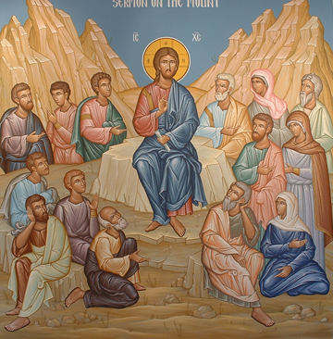
The Spirit of Life
4th Sunday of Baonah 2015

Slide 2
The Spirit of Life
For the law of the Spirit of life in Christ Jesus has made me free from the law of sin and death. Rom 8:2

Slide 3
“Son of man, can these bones live?”
9 Also He said to me, “Prophesy to the breath, prophesy, son of man, and say to the breath, ‘Thus says the Lord God: “Come from the four winds, O breath, and breathe on these slain, that they may live.”’” 10 So I prophesied as He commanded me, and breath came into them, and they lived, and stood upon their feet, an exceedingly great army. Eze 37:9,10

Slide 4
St. Basil the Great
"On the Holy Spirit"
Through the Holy Spirit comes our restoration to paradise, our ascension into the kingdom of heaven, our return to the adoption of sons, our liberty to call God our Father, our being made partakers of the grace of Christ, our being called children of light, our sharing in eternal glory, and, in a word, our being brought into a state of all "fullness of blessing”.

Slide 5
Is it Possible?!!!
27 “But I say to you who hear: Love your enemies, do good to those who hate you, 28 bless those who curse you, and pray for those who spitefully use you. Luke 6:27,28

Slide 6
He Did it ..
And you He made alive, who were dead in trespasses and sins, Eph 2:1

Slide 7
Through his Spirit
But if the Spirit of Him who raised Jesus from the dead dwells in you, He who raised Christ from the dead will also give life to your mortal bodies through His Spirit who dwells in you. Rom 8:11

Slide 8
St. Macarius the Great “Spiritual Homilies (Homily 24)
Whatever the soul may think fit to do itself, whatever care and pains it may take, relying only upon its own power, and thinking to be able to effect a perfect success by itself, without the co-operation of the Spirit, it is greatly mistaken. It is of no use for the heavenly places; it is of no use for the kingdom

Slide 9
Passed from death to Life
14 We know that we have passed from death to life, because we love the brethren. He who does not love his brother abides in death. 15 Whoever hates his brother is a murderer, and you know that no murderer has eternal life abiding in him. I Jn 3:14,15

Slide 10
Origen
As now by participation in the Son of God one is adopted as a son, and by participating in that wisdom which is in God is rendered wise, so also by participation in the Holy Spirit is a man rendered holy and spiritual.
Origen De Principiis. Book IV Chapter I.32

Slide 11
Applications
Did you try before and failed?
Did you try by your own power?
Rely on the spirit of Life
Enjoy the new life in Him through Him
Believe in the mystical act and persevere

