Slide 1
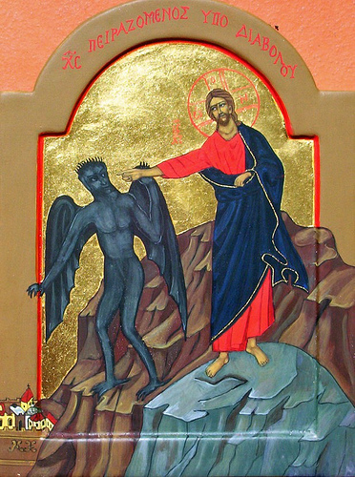
The Move (3) From defeated Adam to Victorious Adam
Great Lent 2016

Slide 2
Moving mountains
So Jesus said to them, “Because of your unbelief; for assuredly, I say to you, if you have faith as a mustard seed, you will say to this mountain, ‘Move from here to there,’ and it will move; and nothing will be impossible for you. Matt 17:20

Slide 3
The Move
From a superficial to an intimate relationship
From earthly to heavenly treasures
From defeated Adam to Victorious Adam

Slide 4
Theophilus of Antioch
Adam and Eve were created neither immortal nor mortal. They were created with the potential to become either through obedience or disobedience

Slide 5
The trap
4 Then the serpent said to the woman, “You will not surely die. 5 For God knows that in the day you eat of it your eyes will be opened, and you will be like God, knowing good and evil.” Gen 3:4,5

Slide 6
The Fall
So when the woman saw that the tree was good for food, that it was pleasant to the eyes, and a tree desirable to make one wise, she took of its fruit and ate. She also gave to her husband with her, and he ate. Gen 3:6

Slide 7
The Victory for us
Then Jesus said to him, “Away with you, Satan! For it is written, ‘You shall worship the Lord your God, and Him only you shall serve.’” Matt 4:10

Slide 8
St. John Chrysostom
Satan went up to man (Adam) to tempt him but Satan cannot attack Jesus, it was Jesus who went up to him.

Slide 9
Warning
But I fear, lest somehow, as the serpent deceived Eve by his craftiness, so your minds may be corrupted from the simplicity that is in Christ. 2 Cor 11:3

Slide 10
To the Obedience of Christ
casting down arguments and every high thing that exalts itself against the knowledge of God, bringing every thought into captivity to the obedience of Christ, 2 Cor 10:5

Slide 11
(St. Basil the Great)
Every sin is an expression of disregard of the divine law, and is considered as ‘haughtiness’ against the knowledge of God.
On The Judgment Of God.

Slide 12
The theology of St. Cyril Dr. Daniel Keating , pp 168
The indwelling of Christ through participation in the Eucharist possesses a certain excellence of Cyril because of the ‘Natural Participation’ (μέθεξις φυσική) it established... This natural participation, obtained by the commingling (mixing together) of Christ’s life flesh with our bodies.

