Slide 1
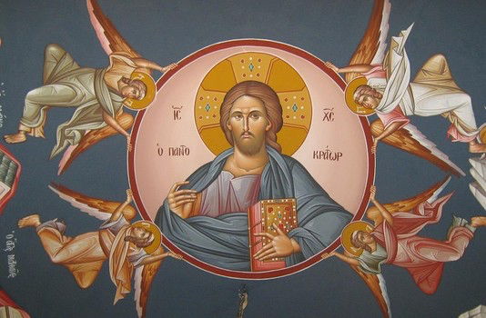
The Move (2) Riches from Earth to Heaven
Treasures’ Sunday 2016

Slide 2
A Command
19 “Do not lay up for yourselves treasures on earth, where moth and rust destroy and where thieves break in and steal; 20 but lay up for yourselves treasures in heaven, where neither moth nor rust destroys and where thieves do not break in and steal. 21 For where your treasure is, there your heart will be also. Matt 6:19-21

Slide 3
One master
24 “No one can serve two masters; for either he will hate the one and love the other, or else he will be loyal to the one and despise the other. You cannot serve God and mammon. Matt 6

Slide 4
The Plunder
'I will also give over all the wealth of this city, all its produce and all its costly things; even all the treasures of the kings of Judah I will give over to the hand of their enemies, and they will plunder them, take them away and bring them to Babylon. Jer 20: 5

Slide 5
Rotten riches
Your riches have rotted and your garments have become moth-eaten. Your gold and your silver have rusted; and their rust will be a witness against you and will consume your flesh like fire. It is in the last days that you have stored up your treasure! Jas 5:2,3

Slide 6
St Hilary of Arles
The rich must repent while there is still time for them to do so. James is speaking here of those rich people who have shown themselves to be too stingy to offer any help to the poor.
Introductory Tractate on the Letter of James, PL Supp. 3:80 (Ancient Christian Commentary on Scripture).

Slide 7
Are you really rich?
'Because you say, "I am rich, and have become wealthy, and have need of nothing," and you do not know that you are wretched and miserable and poor and blind and naked, Rev 3:17

Slide 8
St. John Cassian
We saw many of the cold people, monks and laymen, turn to be spiritually warm but we have not seen lukewarm persons becoming warm.

Slide 9
He richly supplies us with all things
Instruct those who are rich in this present world not to be conceited or to fix their hope on the uncertainty of riches, but on God, who richly supplies us with all things to enjoy. 1 Tim 6:17

Slide 10
Righteousness Vs Riches
Riches do not profit in the day of wrath, But righteousness delivers from death. Prov. 11:4

Slide 11
Earthen Vessels
7 But we have this treasure in earthen vessels, that the excellence of the power may be of God and not of us. 2 Cor 4:7

Slide 12
Clement of Alexandria
"’Eat my flesh,’ [Jesus] says, ‘and drink my blood.’ The Lord supplies us with these intimate nutrient, he delivers over his flesh and pours out his blood, and nothing is lacking for the growth of his children" (The Instructor of Children 1:6:43:3 [A.D. 191]).

