Slide 1
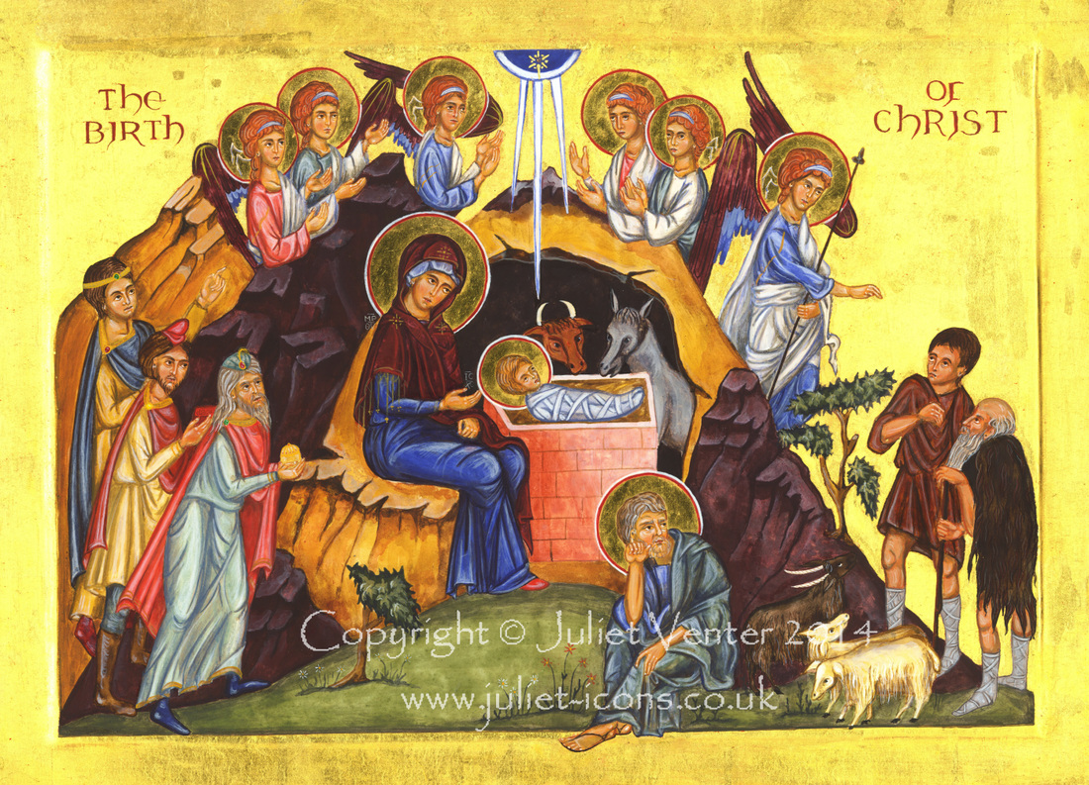
The Mediator of the Concord
Christmas Message 2016

Slide 2
1. A cry for a Mediator
Nor is there any mediator between us, Who may lay his hand on us both. Job 9:33

Slide 3
2- The Mediator has come
For there is one God and one Mediator between God and men, the Man Christ Jesus, 1 Tim 2:5

Slide 4
3 – He is our Reconciler and Concord
Now all things are of God, who has reconciled us to Himself through Jesus Christ, and has given us the ministry of reconciliation. 2 Cor 2:18

Slide 5
St Irenaeus
Against Heresies III, 18, 7; ANF I, p. 448.
Therefore, as I have already said, He (Christ) caused man to cleave to and to become one with God. For unless man had been joined to God, he could never have become a partaker of incorruptibility.

Slide 6
St Irenaeus
Against Heresies III, 18, 7; ANF I, p. 448.
For it was incumbent upon the Mediator between God and men, by His relationship to both, to bring both to friendship and concord, and cause God to welcome man, and man to present himself to God.

Slide 7
St Irenaeus
Against Heresies III, 18, 7; ANF I, p. 448.
For, in what way could we be partakers of the adoption of sons, unless we had received from Him through the Son that fellowship which refers to Himself, unless His Word, having been made flesh, had entered into communion with us? Wherefore also He passed through every stage of life, restoring to all communion with God.

Slide 8
St Gregory Nazianzen
Oration 7, 23. NPNF 2nd Ser. Vol. VII, p. 237.
What is this new mystery which concerns me? I am small and great, lowly and exalted, mortal and immortal, earthly and heavenly. I share one condition with the lower world, the other with God; one with the flesh, the other with the spirit. I must be buried with Christ, arise with Christ, be joint heir with Christ, become the son of God, yea, God Himself. ..

Slide 9
St Gregory Nazianzen
Oration 7, 23. NPNF 2nd Ser. Vol. VII, p. 237.
This is the purpose of the great mystery for us. This is the purpose for us of God, Who for us was made man and became poor, to raise our flesh, and recover His image, and remodel man, that we might all be made one in Christ (Gal 3:28),

Slide 10
St Gregory Nazianzen
Oration 7, 23. NPNF 2nd Ser. Vol. VII, p. 237.
who was perfectly made in all of us all that He Himself is, that we might no longer be male and female, barbarian, Scythian, bond or free (Col 3:11)

Slide 11
St Gregory Nazianzen
Oration 7, 23. NPNF 2nd Ser. Vol. VII, p. 237.
(which are badges of the flesh), but might bear in ourselves only the stamp of God, by Whom and for Whom we were made, and have so far received our form and model from Him, that we are recognized by it alone.

Slide 12
Applications
Do I see myself in need for a mediator?
Do I enjoy His Mediation and concord with God?
Is this applicable in my life, in my family and in my work/study place?
Do we enjoy our new Identity in Him?

