Slide 1
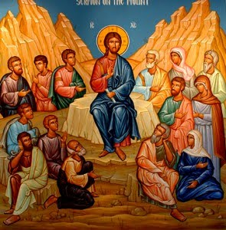
The Change (1): is a Need
Lent’s Eve 2014

Slide 2
1. God Is the Author Of Change
Behold, I will do a new thing, now it shall spring forth; shall you not know it? I will even make a road in the wilderness and rivers in the desert. Is 43:19

Slide 3
2. People Find It Difficult To Change
5 billion gigabytes - volume of data created globally in 2002 - equivalent to 800 books per person. Time 10th November, 2003 p 16
All that new information means a lot of change.
How do people feel about so much change?

Slide 4
3. The beginning
In the year that King Uzziah died, I saw the Lord, high and exalted, seated on a throne; and the train of his robe filled the temple. Isa 6:1

Slide 5
4. Acknowledging the need
5 “Woe to me!” I cried. “I am ruined! For I am a man of unclean lips, and I live among a people of unclean lips, and my eyes have seen the King, the Lord Almighty.” Isa 6:5

Slide 6
5. The Change
6 Then one of the seraphim flew to me with a live coal in his hand, which he had taken with tongs from the altar. 7 With it he touched my mouth and said, “See, this has touched your lips; your guilt is taken away and your sin atoned for.” Isa 6:6,7

Slide 7
6. The mission
8 Then I heard the voice of the Lord saying, “Whom shall I send? And who will go for us?”
And I said, “Here am I. Send me!”

Slide 8
St Gregory of Nyssa
The Great Catechetical oration 37
For as the admixture of a poisonous liquid with a wholesome one the whole drought is deprived of its deadly effect, so too the immortal body, by being within that which receives it, changed the whole into its own nature.

