Slide 1
CRAZYMAKERS
Boundaries and
relationships
part 4

Slide 2
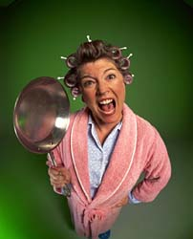
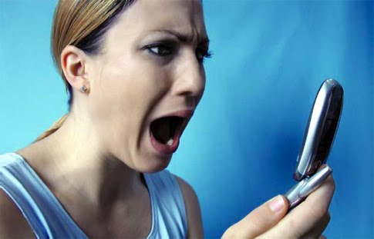

Slide 3
Boundaries define our
area of responsibility.

Slide 4
“Keep your heart with all diligence, for out of it spring the issues of life.” Proverbs 4:23

Slide 5
“Keep your heart with all diligence, for out of it spring the issues of life.” Proverbs 4:23
Anything that affects
my HEART is my responsibility.

Slide 6
What if my boundaries aren’t healthy?

Slide 7
2 Timothy 2:22-23
“Flee also youthful lusts; but pursue righteousness, faith, love, peace with those who call on the Lord out of a pure heart. But avoid foolish and ignorant disputes, knowing that they generate strife.”

Slide 8
Boundary Problems
 | CAN’T SAY | CAN’T HEAR
NO
YES

Slide 9
Boundary Problems
 | CAN’T SAY | CAN’T HEAR
NO
YES | Avoidant

Slide 10
Boundary Problems
 | CAN’T SAY | CAN’T HEAR
NO | Compliant
YES | Avoidant

Slide 11
Boundary Problems
 | CAN’T SAY | CAN’T HEAR
NO | Compliant | Controller
YES | Avoidant | Non-responsive

Slide 12
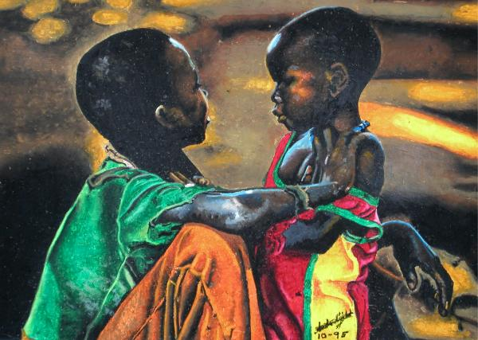
Am I responsible for others? Or just myself?

Slide 13
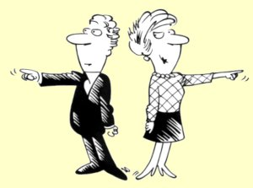
I am responsible TO others, but not FOR others

Slide 14
“Bear one another’s burdens, and so fulfill the law of Christ.” Galatians 6:2
“For each one shall bear his own load.” Galatians 6:5

Slide 15
“But a certain Samaritan, as he journeyed, came where he was. And when he saw him, he had compassion. So he went to him and bandaged his wounds, pouring on oil and wine; and he set him on his own animal, brought him to an inn, and took care of him.” Luke 10:34

Slide 16
“On the next day, when he departed, he took out two denarii, gave them to the innkeeper, and said to him, ‘Take care of him; and whatever more you spend, when I come again, I will repay you.’” Luke 10:35

Slide 17
“The sick man answered Him, “Sir, I have no man to put me into the pool when the water is stirred up; but while I am coming, another steps down before me.” Jesus said to him, “Rise, take up your bed and walk.”” John 5:7-8

Slide 18
1. Start with a Win/Win Mindset

Slide 19
2. Practice Saying No

Slide 20
John 5:30
“I can of Myself do nothing. As I hear, I judge; and My judgment is righteous, because I do not seek My own will but the will of the Father who sent Me.”

Slide 21
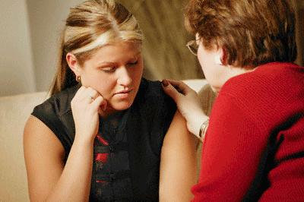
3. Learn to Confront in Love

Slide 22
Matthew 18:15
“Moreover if your brother sins against you, go and tell him his fault between you and him alone. If he hears you, you have gained your brother.”

Slide 23
4. Allow Consequences When Needed

Slide 24
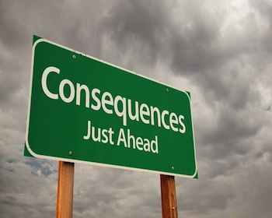
“A hot-tempered person must pay the penalty; rescue them, and you will have to do it again.” Proverbs 19:19

Slide 25
5. Aim not for Equality, but for…

Slide 26
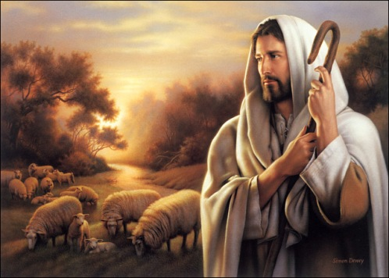
“For the law was given through Moses; grace and truth came through Jesus Christ.” John 1:17

Slide 27
“Finally, brothers and sisters, rejoice! Strive for full restoration, encourage one another, be of one mind, live in peace. And the God of love and peace will be with you.”
2 Corinthians 13:11

