Slide 1
Week 3: Solitude

Slide 2
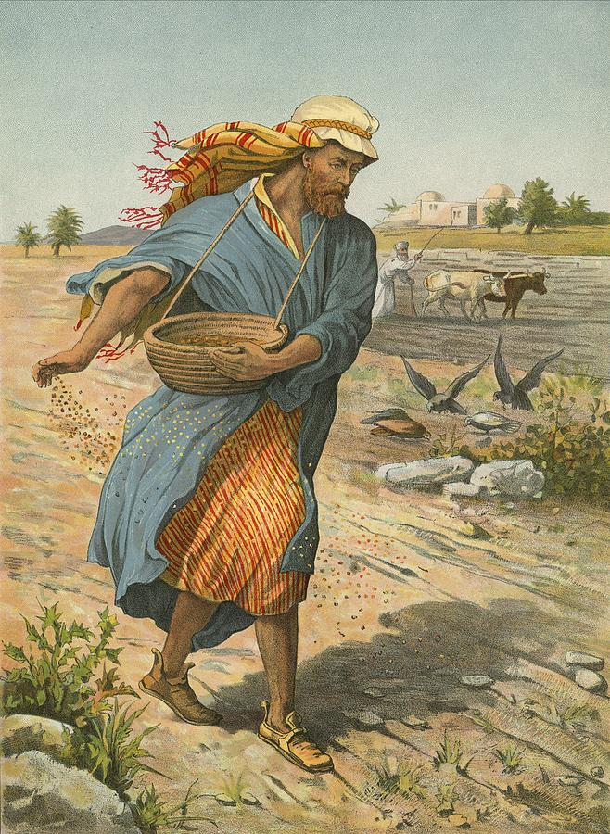
“For he who sows to his flesh will of the flesh reap corruption, but he who sows to the Spirit will of the Spirit reap everlasting life.” Galatians 6:8

Slide 3
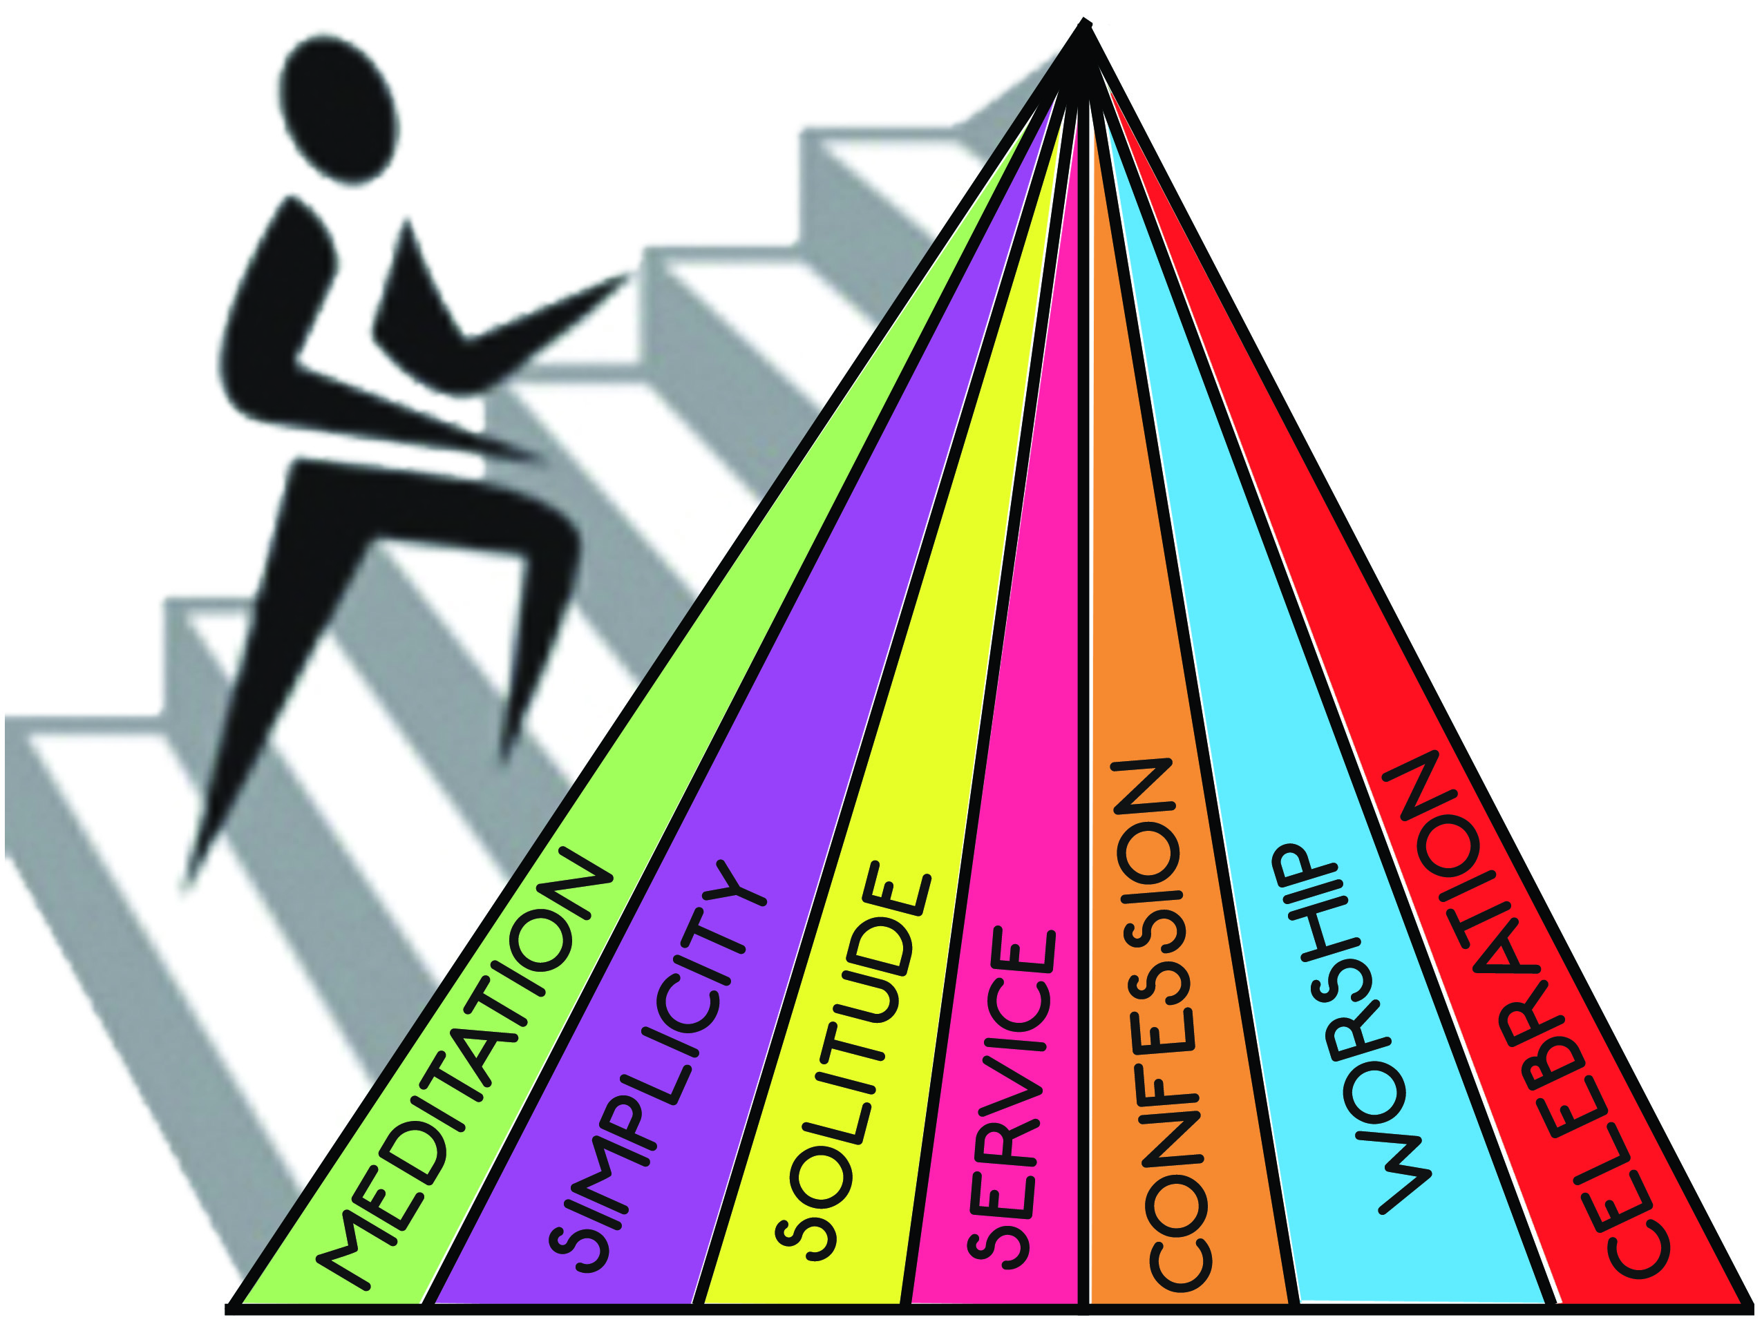

Slide 4
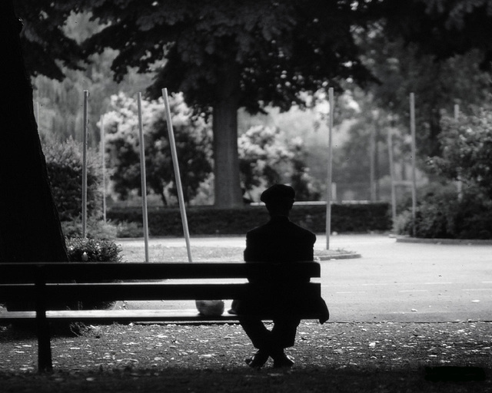
SOLITUDE

Slide 5
“The peace of God, which surpasses all understanding, will guard your hearts and minds through Christ Jesus.” Philippians 4:7

Slide 6
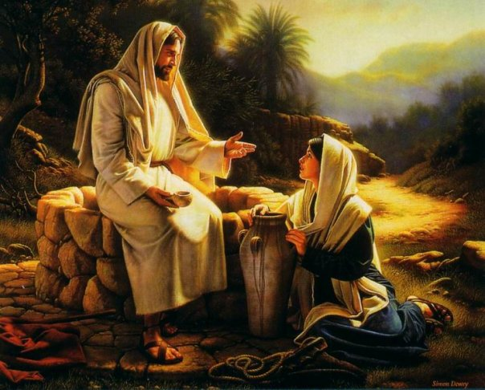
Solitude = ‘being alone with God’

Slide 7
“Now in the morning, having risen a long while before daylight, He went out and departed to a solitary place; and there He prayed.” Mark 1:35

Slide 8
“However, the report went around concerning Him all the more; and great multitudes came together to hear, and to be healed by Him of their infirmities. So He Himself often withdrew into the wilderness and prayed.” Luke 5:16

Slide 9

Purpose = to enable me to handle the world

Slide 10
When Jesus heard it, He departed from there by boat to a deserted place by Himself. But when the multitudes heard it, they followed Him on foot from the cities. And when Jesus went out He saw a great multitude; and He was moved with compassion for them, and healed their sick.” Matthew 14:13-14

Slide 11
“And when He had sent the multitudes away, He went up on the mountain by Himself to pray. Now when evening came, He was alone there.” Matthew 14:23

Slide 12

But what about community?

Slide 13

So solitude means I just need to be quiet more?

Slide 14
Solitude is more than silence.
It is listening.

Slide 15
“It is good for a man to bear the yoke in his youth. Let him sit alone and keep silent” Lamentations 3:27-28

Slide 16
“Guard your steps when you go to the house of God. Go near to listen rather than to offer the sacrifice of fools, who do not know that they do wrong. Do not be quick with your mouth, do not be hasty in your heart to utter anything before God. God is in heaven and you are on earth, so let your words be few.” Ecclesiastes 5:1-2

Slide 17
Steps Into Solitude

Slide 18
Steps Into Solitude
Withdraw Weekly: schedule times for solitude/silence

Slide 19
“Therefore I run thus: not with uncertainty. Thus I fight: not as one who beats the air.” 1 Corinthians 9:26

Slide 20
Steps Into Solitude
Withdraw Weekly: schedule times for solitude/silence
Divert Daily: take time out to be still

Slide 21
“Be still, and know that I am God” Psalm 46:10

Slide 22
Steps Into Solitude
Withdraw Weekly: schedule times for solitude/silence
Divert Daily: take time out to be still
Abandon Annually: plan 2-3 times of retreat per year

Slide 23
God’s purposes are not reasoned, they are revealed
“And the Lord said, “Shall I hide from Abraham what I am doing, since Abraham shall surely become a great and mighty nation, and all the nations of the earth shall be blessed in him?” Genesis 18:18

Slide 24
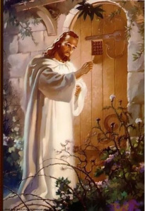
"And He said to them, “Come aside by yourselves to a deserted place and rest a while."
Mark 6:31

