Slide 1

THE ULTIMATE CONVERSATION
September 16, 2012
Part 1

Slide 2
Why don’t we pray more?

Slide 3
Why don’t we pray more?
Not sure how to pray

Slide 4
Why don’t we pray more?
Not sure how to pray
Can’t focus while praying

Slide 5
Why don’t we pray more?
Not sure how to pray
Can’t focus while praying
We think we’re praying for the “wrong” things

Slide 6
Why don’t we pray more?
Not sure how to pray
Can’t focus while praying
We think we’re praying for the “wrong” things
We aren’t sure if our prayers will make any difference

Slide 7

Prayer is
CONVERSATING with God

Slide 8
Psalm 5:1-3
Give ear to my words, O LORD, consider my sighing. Listen to my cry for help, my King and my God, for to you I pray. In the morning, O LORD, you hear my voice; in the morning I lay my requests before you and wait in expectation.

Slide 9


Slide 10
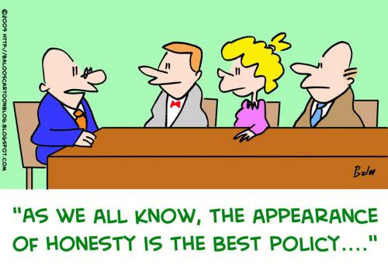
1) GUT LEVEL HONESTY

Slide 11
Exodus 5:22-23
So Moses returned to the Lord and said, “Lord, why have You brought trouble on this people? Why is it You have sent me? For since I came to Pharaoh to speak in Your name, he has done evil to this people; neither have You delivered Your people at all.”

Slide 12
Matthew 6:5, 7
“And when you pray, you shall not be like the hypocrites. For they love to pray standing in the synagogues and on the corners of the streets, that they may be seen by men… And when you pray, do not use vain repetitions as the heathen do. For they think that they will be heard for their many words.”

Slide 13

2) ABOUT EVERYTHING THAT MATTERS TO YOU

Slide 14
Philippians 4:6
“Be anxious for nothing, but in everything by prayer and supplication, with thanksgiving, let your requests be made known to God”

Slide 15
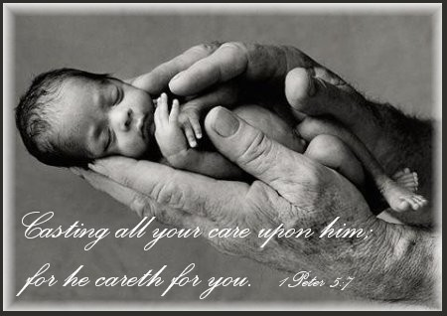

Slide 16
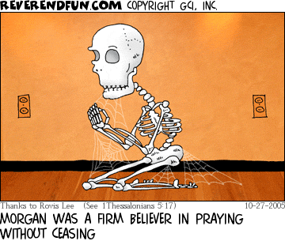
3) TALK CONTINUALLY

Slide 17
1 Thessalonians 5:16-18
“Rejoice always, pray without ceasing, in everything give thanks; for this is the will of God in Christ Jesus for you.”

Slide 18
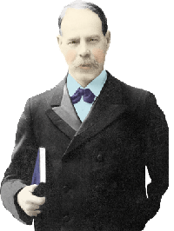
Smith Wigglesworth

Slide 19
Smith Wigglesworth
Never prayed for more than 20 minutes at a time.

Slide 20
Smith Wigglesworth
Never prayed for more than 20 minutes at a time.
But never went more than 20 minutes without praying.

Slide 21

4) LISTEN FOR HIS RESPONSE

Slide 22
Deuteronomy 4:29
“You will seek the Lord your God, and you will find Him if you seek Him with all your heart and with all your soul.”

Slide 23
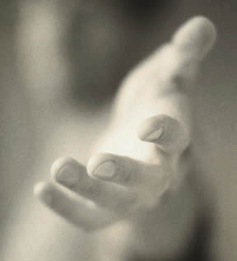
“Call to Me, and I will answer you, and show you great and mighty things, which you do not know.” Jeremiah 33:3

