Slide 1
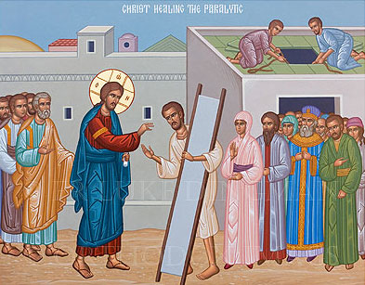
It's Time to Rip the Roof Off This Place!
2nd Sunday Baonah

Slide 2
St. John Chrysostom, Conversations on the Book of Genesis, 29.1
Of all the afflictions that burden the human race, there is not one, whether spiritual or bodily, that cannot be healed by the Holy Scriptures.

Slide 3
They went out of their way.
18 Then behold, men brought on a bed a man who was paralyzed, whom they sought to bring in and lay before Him. 19 And when they could not find how they might bring him in, because of the crowd, they went up on the housetop and let him down with his bed through the tiling into the midst before Jesus. Luke 5:18,19

Slide 4
Deuteronomy 31:8
It is the Lord who goes before you. He will be with you; he will not leave you or forsake you. Do not fear or be dismayed.”

Slide 5
They were persistent.
18 Then behold, men brought on a bed a man who was paralyzed, whom they sought to bring in and lay before Him. 19 And when they could not find how they might bring him in, because of the crowd, they went up on the housetop and let him down with his bed through the tiling into the midst before Jesus. Luke 5: 18,19

Slide 6
Galatians 6:9
And let us not grow weary of doing good, for in due season we will reap, if we do not give up.

Slide 7
They took a risk.
And when they could not find how they might bring him in, because of the crowd, they went up on the housetop and let him down with his bed through the tiling into the midst before Jesus. Luke 5:19

Slide 8
Jeremiah 33:3
Call to me and I will answer you, and will tell you great and hidden things that you have not known.

Slide 9
They carried the weight.
18 Then behold, men brought on a bed a man who was paralyzed, whom they sought to bring in and lay before Him. 19 And when they could not find how they might bring him in, because of the crowd, they went up on the housetop and let him down with his bed through the tiling into the midst before Jesus. Luke 5: 18,19

Slide 10
(St. Silouan the Athonite, Writings, XIII.9)
If a man does not tell everything to his spiritual father, then his path is crooked and does not lead to the Kingdom of Heaven. But the path of one who tells everything leads directly to the Kingdom of Heaven.

Slide 11
Bear you one another's burdens, and so fulfill the law of Christ. Gal 6:2

Slide 12
(St. Barsanuphius the Great, Instructions, 166)
Having God, fear nothing, but cast all of your care upon Him, and He will take care of you. Believe undoubtingly, and God will help you according to His mercy.

