Slide 1
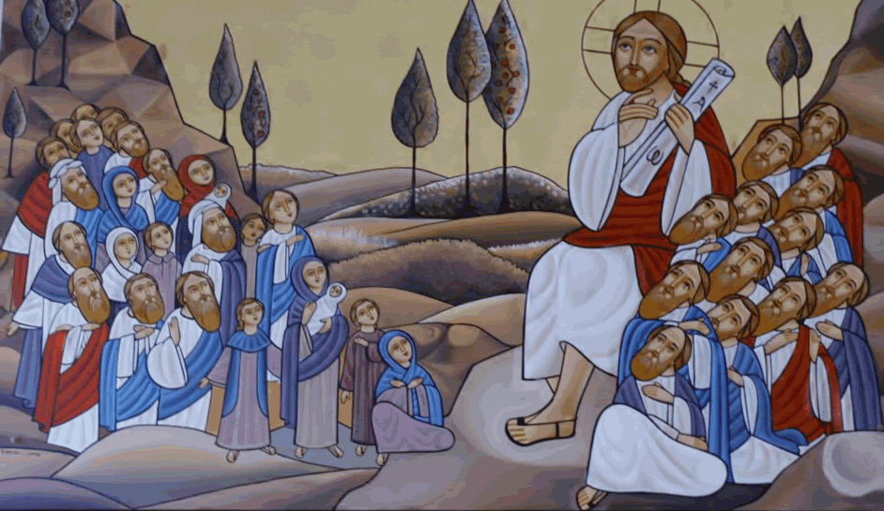
Pride casts us out, Humility restores us
3rd Sunday of Amsheer

Slide 2
His Will
37 All that the Father gives Me will come to Me, and the one who comes to Me I will by no means cast out. 38 For I have come down from heaven, not to do My own will, but the will of Him who sent Me. Jn 6:37,38

Slide 3
Pride is the cause of all diseases
This is the reason why he does not cast out those who come to him. “For I came down from heaven not to do my own will but the will of him that sent me.” The soul departed from God because it was proud.

Slide 4
Humility restores
… Pride casts us out, humility restores us.… When a physician in the treatment of a disease cures certain outward symptoms but not the cause that produces them, his cure is only temporary. So long as the cause remains, the disease may return.…

Slide 5
Imitate the Humble God
That the cause then of all diseases, that is, pride, might be eradicated, the Son of God humbled himself. Why are you proud, O man? The Son of God humbled himself for you. It might shame you, perhaps, to imitate a humble man; but imitate at least a humble God.…

Slide 6
Pride does its own will
And this is the proof of his humility: “I came not to do my own will but the will of him that sent me.” Pride does its own will; humility does the will of God. For this very reason, therefore, I will not cast out the one who comes to me, because I came not to do my own will, but the will of him who sent me. I came to teach humility by being humble myself.

Slide 7
Those who are Christ’s
And those who are Christ’s have crucified the flesh with its passions and desires. Gal 5:24

Slide 8
Those who are NOT Christ’s
And those who are NOT Christ’s have NOT crucified the flesh with its passions and desires, AND THEY ARE DOING THEIR OWN WILL

Slide 9
We are members of Him
Whoever comes to me is made a member of me. Such a person is necessarily humble, because he will not do his own will but the will of God; and therefore [this person] is not cast out. He was cast out, as proud.… But he will not cast us out because we are members of the one who desired to be our head by teaching us humility.
St Augustine : Tractates on the Gospel of John 25.15-16, 18. [NPNF 1 7:165-67**.]

Slide 10
Comes to Me
45 It is written in the prophets, ‘And they shall all be taught by God.’ Therefore everyone who has heard and learned from the Father comes to Me. Jn 6:45

Slide 11
The Bread of life
The Bread of life, which came down for us from heaven, has given life to the world.
You have brought Him forth without blemish; He gave us His body and His precious blood, and we live forever.

