Slide 1
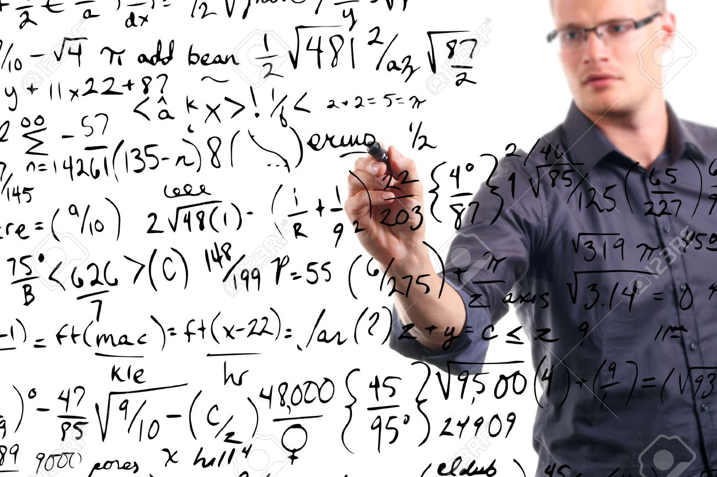
Higher Math
3rd Sunday of Hatour

Slide 2
Multitudes
25 Now great multitudes went with Him. And He turned and said to them, Lk 14:25

Slide 3
Jesus Sifting them
26 “If anyone comes to Me and does not hate his father and mother, wife and children, brothers and sisters, yes, and his own life also, he cannot be My disciple. 27 And whoever does not bear his cross and come after Me cannot be My disciple. Lk 14:26,27

Slide 4
Hate = Sena (Syriac)= Put aside
26 “If anyone comes to Me and does not hate (put aside) his father and mother, wife and children, brothers and sisters, yes, and his own life also, he cannot be My disciple. Lk 14:26

Slide 5
St Cyril of Alexandria (on Lk 14)
It is plain that He permits us to love, but not more than we do Him. For He demands for Himself our chief affection; and that very justly: for the love of God in those who are perfect in mind has something in it superior both to the honor due to parents, and to the natural affection felt for children.

Slide 6
Example (1)
28 For which of you, intending to build a tower, does not sit down first and count the cost, whether he has enough to finish it— 29 lest, after he has laid the foundation, and is not able to finish, all who see it begin to mock him, 30 saying, ‘This man began to build and was not able to finish’? Lk 14:28-30

Slide 7
Example (2)
31 Or what king, going to make war against another king, does not sit down first and consider whether he is able with ten thousand to meet him who comes against him with twenty thousand? 32 Or else, while the other is still a great way off, he sends a delegation and asks conditions of peace. Lk 14:31,32

Slide 8
St Cyril of Alexandria
For those whose choice it is to lead a glorious and blameless life ought to store up beforehand in their mind a zeal sufficient thereunto, and to remember him who says, "My son, if you draw near to serve the Lord, prepare yourself for every temptation: make your heart straight, and endure.'" But those who have no such zeal, how will they be able to reach the mark that is set before them?

Slide 9
Forsake all
So likewise, whoever of you does not forsake all that he has cannot be My disciple. Lk 14:33

Slide 10
Pauline
which is manifest evidence of the righteous judgment of God, that you may be counted worthy of the kingdom of God, for which you also suffer; 1 Thess 1:5

Slide 11
Catholic Epistle
4 In regard to these, they think it strange that you do not run with them in the same flood of dissipation, speaking evil of you. 5 They will give an account to Him who is ready to judge the living and the dead. 1 Pet 4:4,5

Slide 12
Acts
38 And now I say to you, keep away from these men and let them alone; for if this plan or this work is of men, it will come to nothing; 39 but if it is of God, you cannot overthrow it—lest you even be found to fight against God.” Acts 5:38,39

Slide 13
Liturgy of St Cyril
Give Your ear, O Lord, and hear us, who now submit to You, cleanse our inner person as Your Only Begotten Son is pure, He Who we wish to partake of

