Slide 1
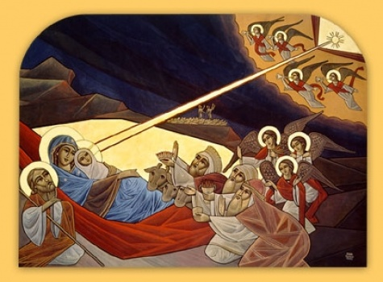

Slide 2
Letter from HH Pope Shenouda
“Amongst the words that I remember on the occasion of the Feast of the Nativity, is what was said about Him during His Incarnation, that He “went about doing good” (Acts 10:38). It is a lesson to us in our lives, to be like Him, going about doing good.”

Slide 3
Letter from HH Pope Shenouda
Goodness is not only leaving sin, for this is only the negative aspect. The most important aspect however, is the positive side. That is, doing good with everyone, in order that everyone who meets us on the path of life will gain goodness, by any means.

Slide 4
Letter from HH Pope Shenouda
My beloved children, place this principle in front of you in this New Year: that every day you do not do good, do not count this day as day of your lives. God created you in His image and God is the Beneficent One. So you also be likewise, in the image of Your Heavenly Father, beneficent as He is. Let this not only be when people ask from you to do good to them, but rather do not wait for them to ask.

Slide 5

Success is ____________ ???

Slide 6
Success is ____________ ???
See James 4:17

Slide 7
Success is ____________ ???
“Therefore, to him who knows to do good and does not do it, to him it is sin.” James 4:17

Slide 8
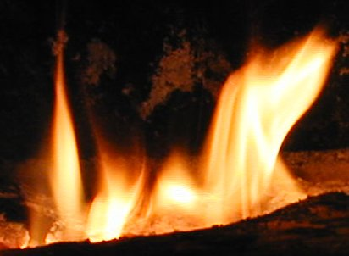
James 2:17-18
“Thus also faith by itself, if it does not have works, is dead. But someone will say, You have faith, and I have works. Show me your faith without your works, and I will show you my faith by my works.”

Slide 9
Remember: God takes notice of all

Slide 10
Remember: God takes notice of all
Bad news: God takes notice of all

Slide 11
Remember: God takes notice of all
Bad news: God takes notice of all
Good news: God takes notice of ALL

Slide 12
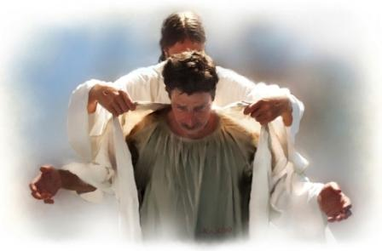
“And whoever gives one of these little ones only a cup of cold water in the name of a disciple, assuredly, I say to you, he shall by no means lose his reward.” Matthew 10:42

