Slide 1
Weird Desires
Weird Series
Because normal just isn’t working

Slide 2
Key verse
“Enter by the narrow gate; for wide is the gate and broad is the way that leads to destruction, and there are many who go in by it. ¹⁴ Because narrow is the gate and difficult is the way which leads to life, and there are few who find it.”
Matthew 7:13-14

Slide 3
Natural Desires
“For all that is in the world—the lust of the flesh, the lust of the eyes, and the pride of life—is not of the Father but is of the world. ¹⁷ And the world is passing away, and the lust of it; but he who does the will of God abides forever.” 1 John 2:16-17

Slide 4
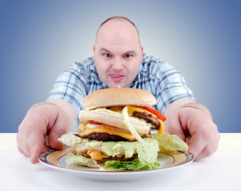
The cravings of the world
Physical pleasure – the lust of the flesh
Everything that we see – the lust of the eyes
Pride in Achievements and our Possessions- the Pride of life

Slide 5

Normal Desires
Normal people want what they want now not later

Slide 6

Normal Desires
2. Normal people, they will often trade the ultimate for the immediate

Slide 7
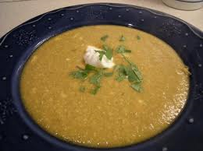

Want my bowl of stew!
or

Slide 8
I’m gonna die!
“Now Jacob cooked a stew; and Esau came in from the field, and he was weary. ³⁰ And Esau said to Jacob, “Please feed me with that same red stew, for I am weary.” Therefore his name was called Edom.^{[d]31} But Jacob said, “Sell me your birthright as of this day.” ³² And Esau said, “Look, I am about to die; so what is this birthright to me?” ³³ Then Jacob said, “Swear to me as of this day.”
So he swore to him, and sold his birthright to Jacob. ³⁴ And Jacob gave Esau bread and stew of lentils; then he ate and drank, arose, and went his way. Thus Esau despised his birthright. “Genesis 25:29-33

Slide 9
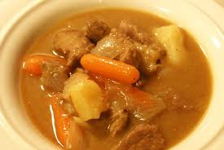
What’s your bowl of stew?

Slide 10
Proverbs 16:32
“He who is slow to anger is better than the mighty,
And he who rules his spirit than he who takes a city.”
Better to be patient than powerful
Better to have self control than to conquer a city.

Slide 11

Weird Desires
1. Weird people know that later is often better than now.

Slide 12
Weird Desires
2. Weird people seek God until His desires become my desires

Slide 13
Psalm 37:4
^{“4} Delight yourself also in the LORD, And He shall give you the desires of your heart.”

Slide 14
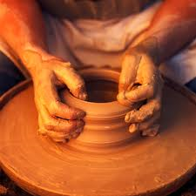
Delight
Hebrew word for “delight” – anag
as you're seeking, as you're enjoying, as you're delighting, you will be made soft or pliable, soft or pliable

Slide 15

Spirit vs Flesh
“Walk in the Spirit, and you shall not fulfill the lust of the flesh. ¹⁷ For the flesh lusts against the Spirit, and the Spirit against the flesh; and these are contrary to one another, so that you do not do the things that you wish.”
Galatians 5:16-17

