Slide 1
Weird Series
Normal just isn’t working
Light and Life Fall 2011

Slide 2
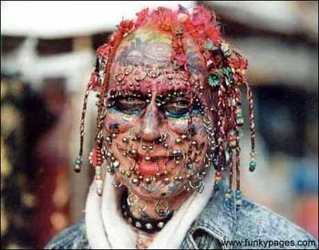
Weird!!

Slide 3
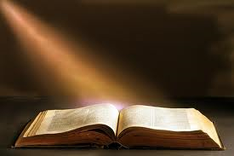
Word of God

Slide 4
Matthew 7:13-14
“Enter by the narrow gate; for wide is the gate and broad is the way that leads to destruction, and there are many who go in by it. ¹⁴ Because narrow is the gate and difficult is the way which leads to life, and there are few who find it.”

Slide 5
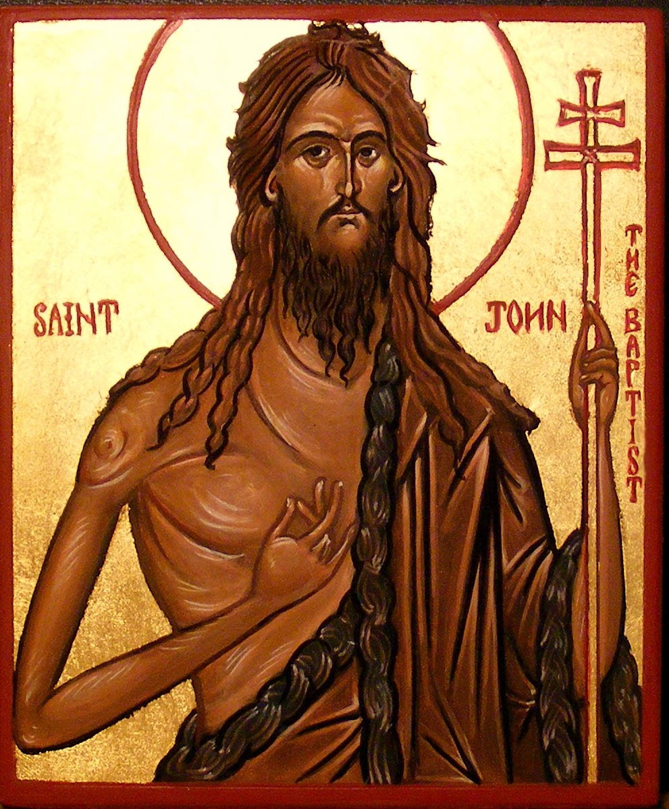
The good kind of weird

Slide 6
Mark 1:2-6
“ Behold, I send My messenger before Your face,Who will prepare Your way before You.”^{[b]} ³ “ The voice of one crying in the wilderness: ‘ Prepare the way of the LORD; Make His paths straight.’”^{[c]}
⁴ John came baptizing in the wilderness and preaching a baptism of repentance for the remission of sins. ⁵ Then all the land of Judea, and those from Jerusalem, went out to him and were all baptized by him in the Jordan River, confessing their sins.
⁶ Now John was clothed with camel’s hair and with a leather belt around his waist, and he ate locusts and wild honey.”

Slide 7
Matthew 11:7-9,11
“⁷ As they departed, Jesus began to say to the multitudes concerning John: “What did you go out into the wilderness to see? A reed shaken by the wind? ⁸ But what did you go out to see? A man clothed in soft garments? Indeed, those who wear soft clothing are in kings’ houses. ⁹ But what did you go out to see? A prophet? Yes, I say to you, and more than a prophet.”
v.11 “Assuredly, I say to you, among those born of women there has not risen one greater than John the Baptist; but he who is least in the kingdom of heaven is greater than he.”

Slide 8
Key note
If you want what normal people have , do what normal people do.
But if you want what few people have, do what few people.

Slide 9
Matthew 5:27-28
“You've heard it said, don't commit adultery. But I say unto you, don't even look lustfully at a woman. Whoever has looked lustfully at a woman has already committed adultery in his heart.”

Slide 10
1- Weird people don't think like normal people think.

Slide 11

Romans 12:2
“And do not be conformed to this world, but be transformed by the renewing of your mind, that you may prove what is that good and acceptable and perfect will of God.”

Slide 12
Change of thinking
The way you think determines the way you behave

Slide 13
2- Weird people don’t live like the normal people live

Slide 14
2 Peter 2:11-12
“Beloved, I beg you as sojourners and pilgrims, abstain from fleshly lusts which war against the soul, ¹² having your conduct honorable among the Gentiles, that when they speak against you as evildoers, they may, by your good works which they observe, glorify God in the day of visitation.”

Slide 15
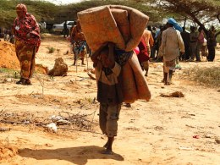
This world is not our home!

