Slide 1
Agents of Change Series
Counting the Cost

Slide 2
Rewards

Slide 3
Facing our daily tasks with a whole new sense of purpose

Slide 4
Ashley Smith

Slide 5
Spiritual Growth

Slide 6
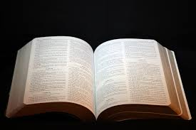
Bible reading becomes purposeful seeking to know more about His character

Slide 7
Sharing our faith infuses life into our prayer lives

Slide 8
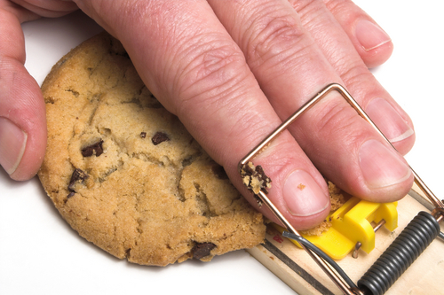
Helps you maintain a high standard of conduct

Slide 9
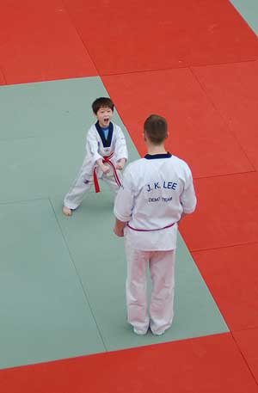
Spiritual Confidence

Slide 10
Honor of being God’s Agent
⁸ But you shall receive power when the Holy Spirit has come upon you; and you shall be witnesses to Me in Jerusalem, and in all Judea and Samaria, and to the end of the earth.”

Slide 11
Fulfillment
Jesus said to them, “My food is to do the will of Him who sent Me, and to finish His work. ³⁵ Do you not say, ‘There are still four months and then comes the harvest’? Behold, I say to you, lift up your eyes and look at the fields, for they are already white for harvest!

Slide 12
Weighing the costs

Slide 13
Time and Energy

Slide 14
Reading and Studying

Slide 15
Money
“Do not lay up for yourselves treasures on earth, where moth and rust destroy and where thieves break in and steal; ²⁰ but lay up for yourselves treasures in heaven, where neither moth nor rust destroys and where thieves do not break in and steal.

Slide 16
Rejection, embarrassment, and persecution

Slide 17
Discussion Questions
Please share any positive rewards experienced from sharing your faith.
How do you think the costs compare to the benefits?
Think of any other potential positive rewards for sharing your faith.

