Slide 1

I believe in God but
I don’t know Him
October 17, 2010
Part 4

Slide 2

“They claim to know God, but by their actions they deny him. They are detestable, disobedient and unfit for doing anything good.”
Titus 1:16

Slide 3
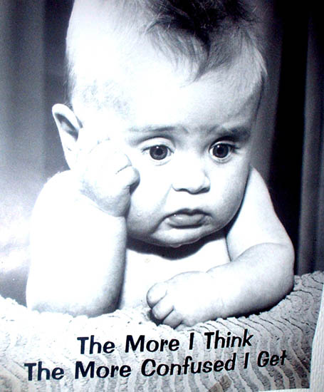
What does it mean to “know God”?

Slide 4
Some believe in God…

Slide 5
Some believe in God…
But don’t know Him

Slide 6
Some believe in God…
But don’t know Him
“Now by this we know that we know Him, if we keep His commandments. He who says, “I know Him,” and does not keep His commandments, is a liar, and the truth is not in him.” 1 John 2:3-4

Slide 7
Some believe in God…
But don’t know Him
“Not everyone who says to Me, ‘Lord, Lord,’ shall enter the kingdom of heaven, but he who does the will of My Father in heaven. Many will say to Me in that day, ‘Lord, Lord, have we not prophesied in Your name, cast out demons in Your name, and done many wonders in Your name?’” Matthew 7:21-22

Slide 8
Some believe in God…
But don’t know Him
“And then I will declare to them, ‘I never knew you; depart from Me, you who practice lawlessness!’” Matthew 7:23

Slide 9
Some believe in God…
But don’t know Him
But don’t know Him well

Slide 10
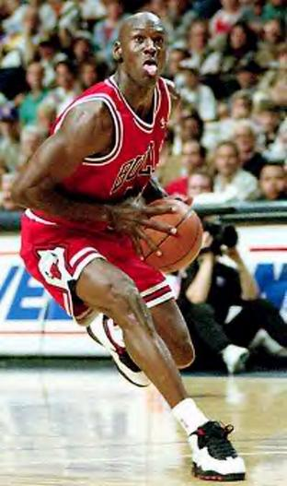
Some believe in God…
But don’t know Him
But don’t know Him well

Slide 11
Some believe in God…
But don’t know Him
But don’t know Him well
“But then, indeed, when you did not know God, you served those which by nature are not gods. But now after you have known God, or rather are known by God, how is it that you turn again to the weak and beggarly elements, to which you desire again to be in bondage?” Galatians 4:8-9

Slide 12
Some believe in God…
But don’t know Him
But don’t know Him well
Know Him intimately & seek Him wholeheartedly

Slide 13
Some believe in God…
But don’t know Him
But don’t know Him well
Know Him intimately & seek Him wholeheartedly
“And you will seek Me and find Me, when you search for Me with all your heart.” Jeremiah 29:13

Slide 14
Psalm 63:1-4
God, you are my God, earnestly I seek you; my soul thirsts for you, my body longs for you, in a dry and weary land where there is no water. I have seen you in the sanctuary and beheld your power and your glory. Because your love is better than life, my lips will glorify you. I will praise you as long as I live, and in your name I will lift up my hands.

Slide 15
Psalm 9:10
“Those who know your name will trust in you, for you, LORD, have never forsaken those who seek you.”

Slide 16
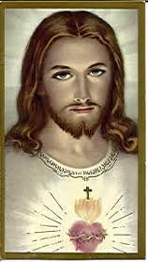
Who Do You Say that I Am?

Slide 17
Who Do You Say that I Am?
“Taste and see that the LORD is good” Psalm 34:8

