Slide 1
I believe in God, but I don’t fear Him
September 26, 2010
Part 1

Slide 2
INSERT VIDEO HERE

Slide 3
I believe in God, but I don’t fear Him
September 26, 2010
Part 1

Slide 4
2 Timothy 3:1-5
“But know this, that in the last days perilous times will come: For men will be lovers of themselves, lovers of money, boasters, proud, blasphemers, disobedient to parents, unthankful, unholy, unloving, unforgiving, slanderers, without self-control, brutal, despisers of good, traitors, headstrong, haughty, lovers of pleasure rather than lovers of God, having a form of godliness but denying its power.”

Slide 5
What is a Practical Atheist?

Slide 6
What is a Practical Atheist?
Someone who BELIEVES in God,
but lives as if He DOESN’T EXIST.

Slide 7
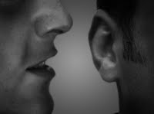
“Sin whispers to the wicked, deep within their hearts. They have no fear of God to restrain them. In their blind conceit, they cannot see how wicked they really are. “ Psalm 36:1-2

Slide 8
Fear of God Begins with AWE

Slide 9
Fear of God Begins with AWE
“By the word of the LORD the heavens were made, and all the host of them by the breath of His mouth. He gathers the waters of the sea together as a heap; He lays up the deep in storehouses. Let all the earth fear the LORD; let all the inhabitants of the world stand in awe of Him.” Psalm 33:6-8

Slide 10
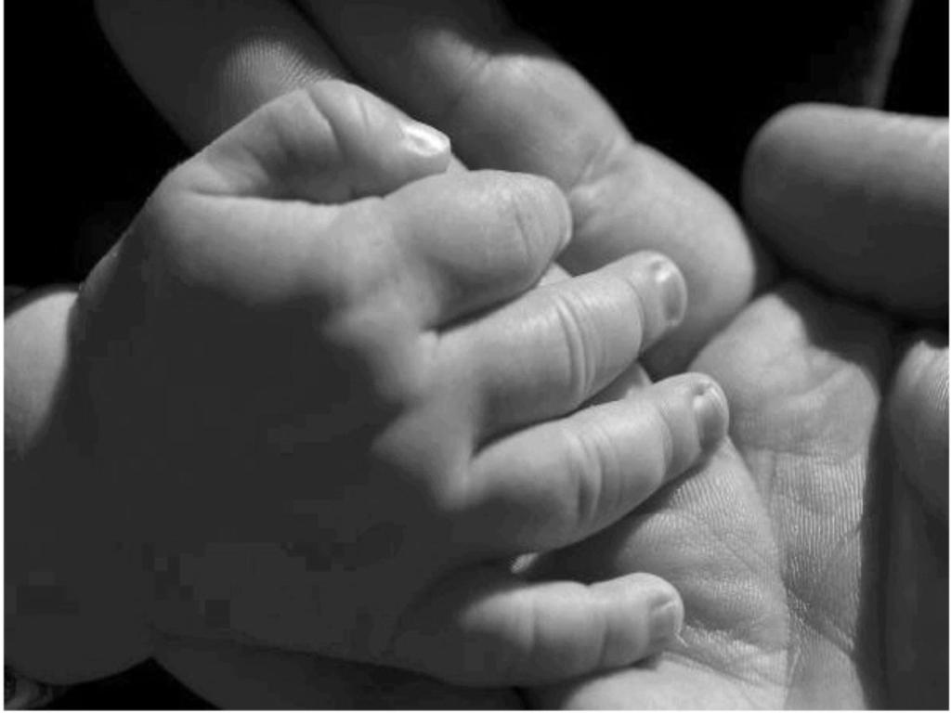
Fear Grows with Relationship

Slide 11
Fear Grows with Relationship
“…Christ Jesus, who, being in the form of God, did not consider it robbery to be equal with God, but made Himself of no reputation, taking the form of a bondservant, and coming in the likeness of men. And being found in appearance as a man, He humbled Himself and became obedient to the point of death, even the death of the cross…” Philippians 2:5-8

Slide 12
Fear Grows with Relationship
“…Therefore, my beloved, as you have always obeyed…work out your own salvation with fear and trembling” Philippians 2:12

Slide 13
When You Truly Fear God…

Slide 14
When You Truly Fear God…
You’ll give yourself to Him wholeheartedly without any condition

Slide 15
When You Truly Fear God…
You’ll give yourself to Him wholeheartedly without any condition
“Do not lay your hand on the lad, or do anything to him; for now I know that you fear God, since you have not withheld your son, your only son, from Me.” Genesis 22:12

Slide 16
When You Truly Fear God…
You’ll give yourself to Him wholeheartedly without any condition
“If you love Me, keep My commandments.” John 14:15

Slide 17
When You Truly Fear God…
You’ll be forever ruined
See Isaiah 6

Slide 18
Isaiah 6:1
“In the year that King Uzziah died, I saw the Lord sitting on a throne, high and lifted up, and the train of His robe filled the temple.”

Slide 19
Isaiah 6:2-4
“Above it stood seraphim; each one had six wings: with two he covered his face, with two he covered his feet, and with two he flew. And one cried to another and said: ‘Holy, holy, holy is the LORD of hosts; the whole earth is full of His glory!’ And the posts of the door were shaken by the voice of him who cried out, and the house was filled with smoke.”

Slide 20
Isaiah 6:5
“So I said: ‘Woe is me, for I am undone [ruined]! Because I am a man of unclean lips, and I dwell in the midst of a people of unclean lips; for my eyes have seen the King, the LORD of hosts.”

Slide 21
Isaiah 6:8
“Also I heard the voice of the Lord, saying: ‘Whom shall I send, and who will go for Us?’ Then I said, ‘Here am I! Send me.’”

Slide 22
Are you living in the
fear of God?

Slide 23
Are you living in the
fear of God?
“Blessed are all who fear the LORD, who walk in his ways. You will eat the fruit of your labor; blessings and prosperity will be yours… Thus is the man blessed who fears the LORD.”
Psalm 128:1-4

