Slide 1
Quit comparing
February 20, 2011
Part 4

Slide 2
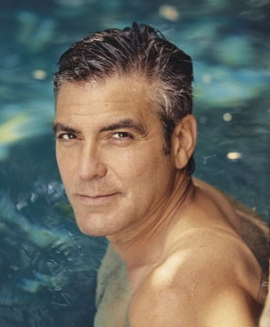
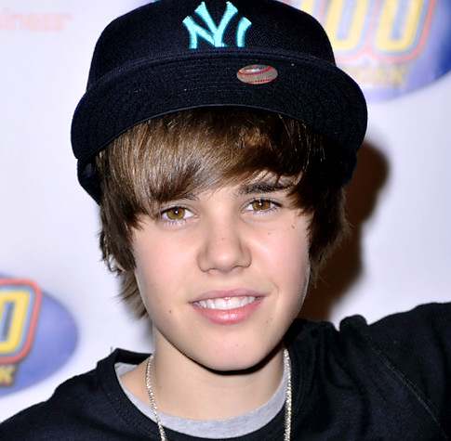
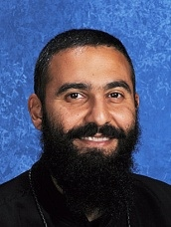
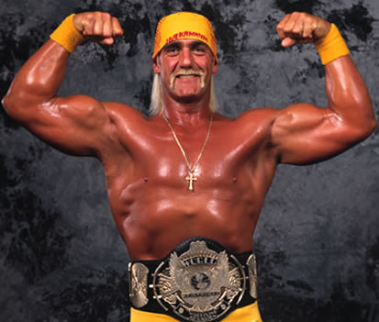
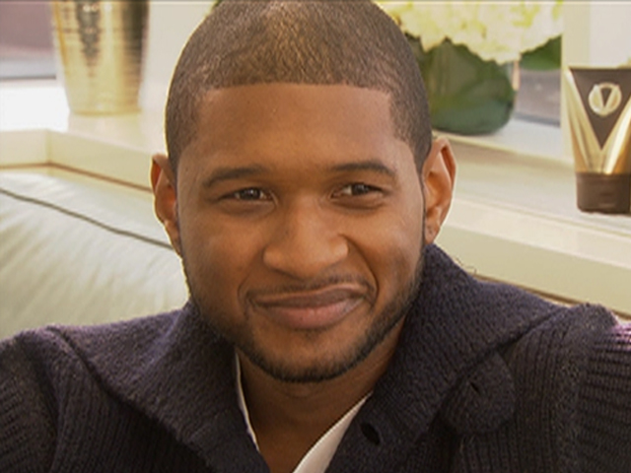

Slide 3
Things We Compare
_____ Possessions
_____ Appearance
_____ Performance
_____ Circumstances

Slide 4
Why does God hate comparing?

Slide 5
Why does God hate comparing?
Comparison is the DEATH of contentment
“For we dare not class ourselves or compare ourselves with those who commend themselves. But they, measuring themselves by themselves, and comparing themselves among themselves, are not wise.” 2 Corinthians 10:12

Slide 6
Why does God hate comparing?
Comparison is the DEATH of contentment
“We say that people are proud of being rich, or clever, or good-looking, but they are not. They are proud of being richer, or cleverer, or better-looking than others. If everyone else became equally rich, or clever, or good-looking, there would be nothing to be proud about.” C.S. Lewis

Slide 7
Why does God hate comparing?
Comparison makes us PRIDEFUL
“The Pharisee stood and prayed thus with himself, ‘God, I thank You that I am not like other men—extortioners, unjust, adulterers, or even as this tax collector. I fast twice a week; I give tithes of all that I possess.’” Luke 18: 11-12

Slide 8
Why does God hate comparing?
Comparison makes us RESENTFUL

Slide 9
1 Samuel 18:6
When the men were returning home after David had killed the Philistine, the women came out from all the towns of Israel to meet King Saul with singing and dancing, with joyful songs and with tambourines and lutes.

Slide 10
1 Samuel 18:7
As they danced, they sang:
‘Saul has slain his thousands,
and David his tens of thousands.’

Slide 11
1 Samuel 18:8-9
Saul was very angry; this refrain galled him. ‘They have credited David with tens of thousands,’ he thought, ‘but me with only thousands. What more can he get but the kingdom?’ And from that time on Saul kept a jealous eye on David.

Slide 12
Why does God hate comparing?
Comparison makes us RESENTFUL
We resent God’s GOODNESS in others’ lives
and we IGNORE God’s blessing in our own life.

Slide 13
So what do we do?

Slide 14
So what do we do?
Know WHAT YOU HAVE
“Not that I speak in regard to need, for I have learned in whatever state I am, to be content: I know how to be abased, and I know how to abound. Everywhere and in all things I have learned both to be full and to be hungry, both to abound and to suffer need. I can do all things through Christ who strengthens me.” Philippians 4:11-13

Slide 15
So what do we do?
Know WHAT YOU HAVE
Know WHO YOU ARE
“For we are His workmanship, created in Christ Jesus for good works, which God prepared beforehand that we should walk in them.” Ephesians 2:10

Slide 16
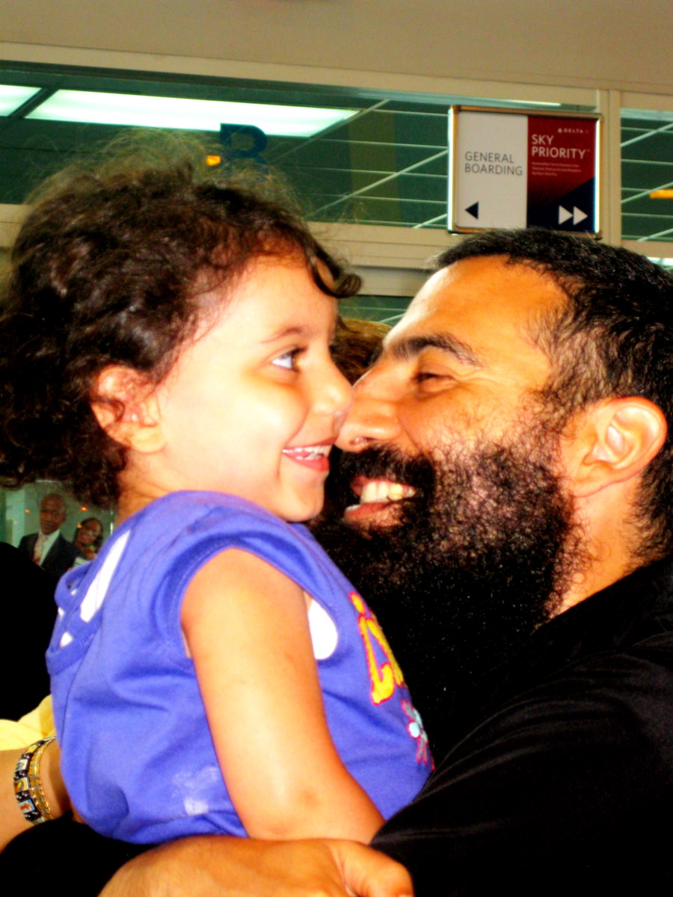
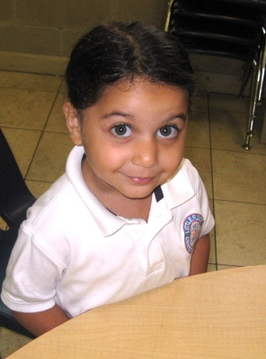
My Little Princess

Slide 17
"I would rather be what God chose to make me than the most glorious creature that I could think of; for to have been thought about, born in God's thought, and then made by God, is the dearest, grandest, and most precious thing in all thinking."
George MacDonald

