Slide 1
JACOB AND LEAH [and rachel]
Part 1
July 10, 2011

Slide 2
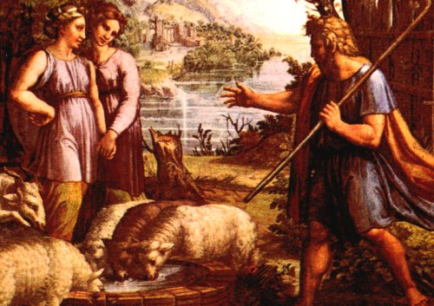

Slide 3
Genesis 29:16-17
“Now Laban had two daughters; the name of the older was Leah, and the name of the younger was Rachel. Leah had weak eyes, but Rachel had a lovely figure and was beautiful.”

Slide 6
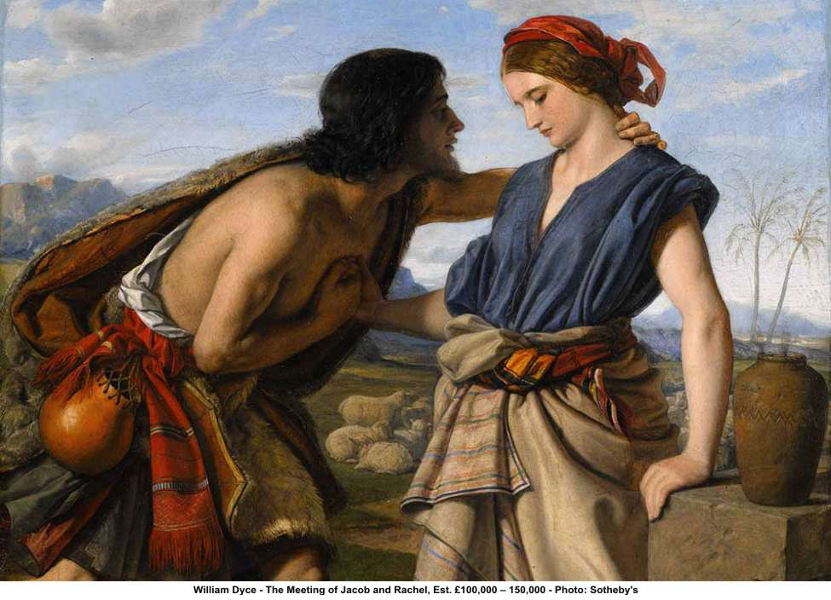

Slide 7
When Marriage is your answer…

Slide 8
When Marriage is your answer…
You will COMPROMISE more than you should
“Jacob was in love with Rachel and said, "I'll work for you seven years in return for your younger daughter Rachel.” Genesis 29:18

Slide 9
When Marriage is your answer…
You become VERY DEMANDING
“Then Jacob said to Laban, "Give me my wife. My time is completed, and I want to lie with her." Genesis 29:21

Slide 10
When Marriage is your answer…
You become VERY DEMANDING
“Then Jacob said to Laban, "Give me my wife. My time is completed, and I want to lie with her." Genesis 29:21
Marriage as covenant?
Or marriage as contract?

Slide 11
When Marriage is your answer…
You always end up DISSATISFIED

Slide 12
When Marriage is your answer…
You always end up DISSATISFIED
“But when evening came, (Laban) took his daughter Leah and gave her to Jacob, and Jacob lay with her... When morning came, there was Leah! So Jacob said to Laban, "What is this you have done to me? I served you for Rachel, didn't I? Why have you deceived me?" Genesis 29:23, 25

Slide 13
When Marriage is your answer…
You always end up DISSATISFIED
“When the Lord saw that Leah was not loved, he opened her womb, but Rachel was barren. Leah became pregnant and gave birth to a son. She named him Reuben, for she said, "It is because the Lord has seen my misery. Surely my husband will love me now.” Genesis 29:31-32

Slide 14
When Marriage is your answer…
You always end up DISSATISFIED
“She conceived again, and when she gave birth to a son she said, “Because the LORD heard that I am not loved, he gave me this one too.” So she named him Simeon. Again she conceived, and when she gave birth to a son she said, “Now at last my husband will become attached to me, because I have borne him three sons.” So he was named Levi." Genesis 29:33-34

Slide 15
What’s missing in this story???

Slide 16
Jesus is the one your spouse is the two

Slide 17
Jesus is the one your spouse is the two
“And my God shall supply all your need according to His riches in glory by Christ Jesus.” Philippians 4:19

Slide 18
Jesus is the one your spouse is the two
“Whoever drinks of the water that I shall give him will never thirst. But the water that I shall give him will become in him a fountain of water springing up into everlasting life.” John 4:14

Slide 19
Genesis 29:35
“She conceived again, and when she gave birth to a son she said, "This time I will praise the Lord." So she named him Judah. Then she stopped having children.”

