Slide 1
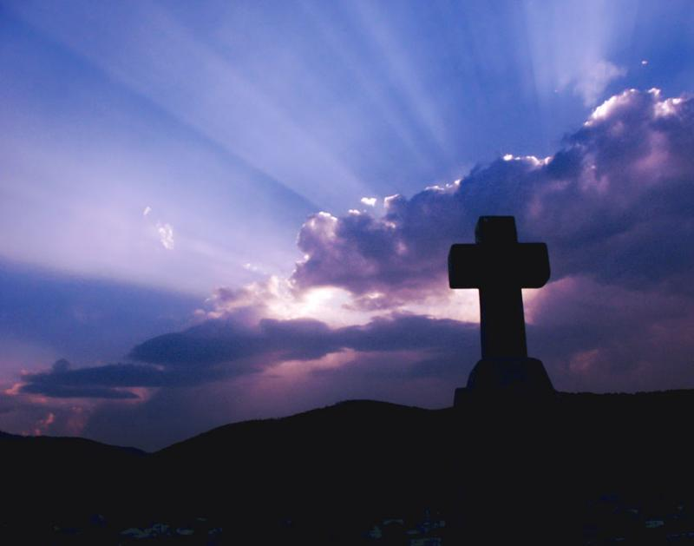
From Deadend to Deliverance
June 5, 2011

Slide 3
The Journey of Faith
Phase 1:
Phase 2:
Phase 3:
Phase 4:
Phase 5:
Phase 6:

Slide 4
The Journey of Faith
Phase 1: DREAM
Phase 2:
Phase 3:
Phase 4:
Phase 5:
Phase 6:

Slide 5
The Journey of Faith
Phase 1: DREAM
Phase 2: DECISION
Phase 3:
Phase 4:
Phase 5:
Phase 6:

Slide 6
The Journey of Faith
Phase 1: DREAM
Phase 2: DECISION
Phase 3: DELAY
Phase 4:
Phase 5:
Phase 6:

Slide 7
The Journey of Faith
Phase 1: DREAM
Phase 2: DECISION
Phase 3: DELAY
Phase 4: DIFFICULTY
Phase 5:
Phase 6:

Slide 8
The Journey of Faith
Phase 1: DREAM
Phase 2: DECISION
Phase 3: DELAY
Phase 4: DIFFICULTY
Phase 5: DEADEND
Phase 6:

Slide 9
The Journey of Faith
Phase 1: DREAM
Phase 2: DECISION
Phase 3: DELAY
Phase 4: DIFFICULTY
Phase 5: DEADEND
Phase 6: DELIVERANCE

Slide 10
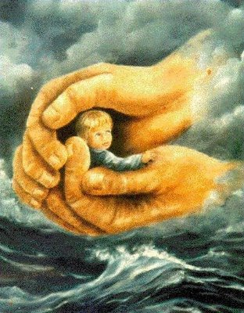
2 Samuel 22:2-3
“The LORD is my rock and my fortress and my DELIVERER; the God of my strength, in whom I will trust”

Slide 11
Three Kinds of Deliverance
Circumstantial deliverance
Personal deliverance
Ultimate deliverance [heaven]

Slide 12
Three Kinds of Deliverance
Circumstantial deliverance
Personal deliverance
Ultimate deliverance [heaven]
“…our God whom we serve is able to deliver us from the burning fiery furnace, and He will deliver us from your hand, O king.” Daniel 3:17

Slide 13
When You Reach the Deadend

Slide 14
When You Reach the Deadend
Remember what God can do
“[Abraham] believed in God, who gives life to the dead and calls those things which do not exist as though they did;” Romans 4:17

Slide 15
When You Reach the Deadend
Remember what God can do
"What is impossible with men is possible with God." Luke 18:27

Slide 16
When You Reach the Deadend
Rely on what God has said
“…who, contrary to hope, in hope believed, so that he became the father of many nations, according to what was spoken, “So shall your descendants be.” Romans 4:18

Slide 17
When You Reach the Deadend
Rely on what God has said
“By faith Abraham, when he was tested, offered up Isaac, and he who had received the promises offered up his only begotten son” Hebrews 11:17

Slide 18
When You Reach the Deadend
Rely on what God has said
“…concluding that God was able to raise him up, even from the dead, from which he also received him in a figurative sense.” Hebrews 11:19

Slide 19
When You Reach the Deadend
Face the facts with faith
“And not being weak in faith, he did not consider his own body, already dead (since he was about a hundred years old), and the deadness of Sarah’s womb. He did not waver at the promise of God through unbelief, but was strengthened in faith, giving glory to God” Romans 4:19-20

Slide 20
When You Reach the Deadend
Face the facts with faith
“while we do not look at the things which are seen, but at the things which are not seen. For the things which are seen are temporary, but the things which are not seen are eternal.” 2 Corinthians 4:18

Slide 21
When You Reach the Deadend
Expect God to deliver me
“He did not waver at the promise of God through unbelief, but was strengthened in faith, giving glory to God, and being fully convinced that what He had promised He was also able to perform.” Romans 4:20-21

Slide 22
When You Reach the Deadend
Expect God to deliver me
“Father, I thank You that You have heard Me. And I know that You always hear Me” John 11:41-42

Slide 23
2 Corinthians 1:9-10
“Yes, we had the sentence of death in ourselves, that we should not trust in ourselves but in God who raises the dead, who delivered us from so great a death, and does deliver us; in whom we trust that He will still deliver us”

Slide 24
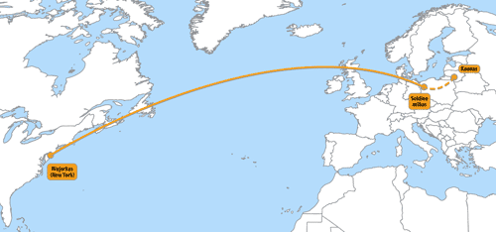
Phase 1: DREAM
Phase 2: DECISION
Phase 3: DELAY
Phase 4: DIFFICULTY
Phase 5: DEADEND
Phase 6: DELIVERANCE

