Slide 1
Focusing Your Life
Surviving the Season – Part 5
December 19, 2010

Slide 2
The goal is not a life of selfishness,
but a life of SIGNIFICANCE.

Slide 3
The goal is not a life of selfishness,
but a life of SIGNIFICANCE.

Slide 4
The goal is not a life of selfishness,
but a life of SIGNIFICANCE.
“Therefore do not be unwise, but understand what the will of the Lord is.” Ephesians 5:7

Slide 5
Life’s Most Important Questions

Slide 6
Life’s Most Important Questions
What will be the CENTER of my life?

Slide 7
Life’s Most Important Questions
What will be the CENTER of my life?
“If riches increase, do not set your heart on them.” Psalm 62:10

Slide 8
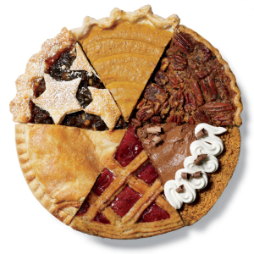
Life’s Most Important Questions
What will be the CENTER of my life?

Slide 9
Life’s Most Important Questions
What will be the CENTER of my life?
Self-centered or God-centered?

Slide 10
Life’s Most Important Questions
What will be the CHARACTER of my life?

Slide 11
Life’s Most Important Questions
What will be the CHARACTER of my life?
“For whom He foreknew, He also predestined to be conformed to the image of His Son” Romans 8:29

Slide 12
Life’s Most Important Questions
What will be the CHARACTER of my life?
“Let this mind be in you which was also in Christ Jesus,” Philippians 2:5

Slide 13
Life’s Most Important Questions
What will be the CHARACTER of my life?
Comfort or character?

Slide 14
Life’s Most Important Questions
What will be the CONTRIBUTION of my life?

Slide 15
Life’s Most Important Questions
What will be the CONTRIBUTION of my life?
“As each one has received a gift, minister it to one another, as good stewards of the manifold grace of God.” 1 Peter 4:10

Slide 16
Life’s Most Important Questions
What will be the CONTRIBUTION of my life?
“For we are His workmanship, created in Christ Jesus for good works, which God prepared beforehand that we should walk in them.” Ephesians 2:10

Slide 17
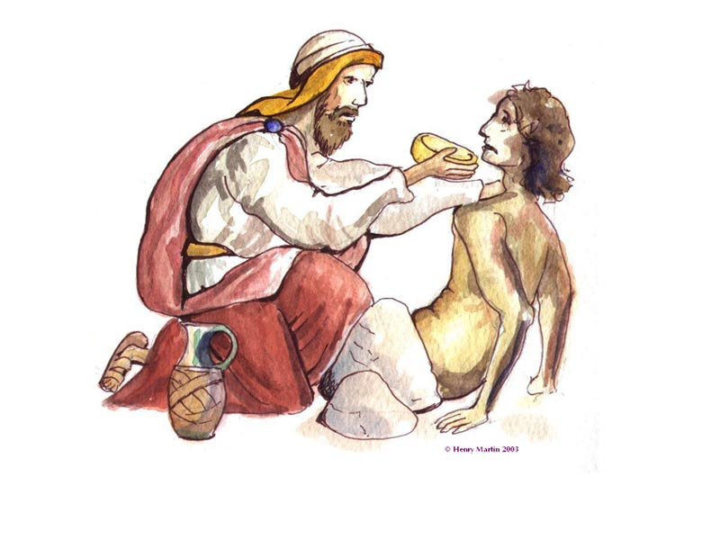
Life’s Most Important Questions
What will be the CONTRIBUTION of my life?

Slide 18
Life’s Most Important Questions
What will be the CONTRIBUTION of my life?
Getting
or giving?

Slide 19
Life’s Most Important Questions
What will be the COMMUNICATION of my life?

Slide 20
Life’s Most Important Questions
What will be the COMMUNICATION of my life?
“For from you the word of the Lord has sounded forth, not only in Macedonia and Achaia, but also in every place. Your faith toward God has gone out, so that we do not need to say anything.” 1 Thessalonians 1:8

Slide 21
Life’s Most Important Questions
What will be the COMMUNICATION of my life?
“Only let your conduct be worthy of the gospel of Christ…” Philippians 1:27

Slide 22
Life’s Most Important Questions
What will be the COMMUNICATION of my life?
“Let your light so shine before men that they may see your good works and glorify your Father in heaven.” Matthew 5:16

Slide 23
Life’s Most Important Questions
What will be the COMMUNICATION of my life?
Promoting myself or sharing Christ?

Slide 24
“I press on, that I may lay hold of that for which Christ Jesus has also laid hold of me… One thing I do, forgetting those things which are behind and reaching forward to those things which are ahead, I press toward the goal for the prize of the upward call of God in Christ Jesus.” Philippians 3:12-14

