Slide 1
Lightening Your Load
Surviving the Season – Part 4
December 12, 2010

Slide 2
Matthew 11:28-30
“Come to Me, all you who labor and are heavy laden, and I will give you REST. Take My yoke upon you and learn from Me, for I am gentle and lowly in heart, and you will find REST for your souls. For My yoke is easy and My burden is light."

Slide 3
How to Lighten Your Load

Slide 4
How to Lighten Your Load
COME TO JESUS
“Come to Me all you who labor and are heavy laden and I will give you rest.”

Slide 5
How to Lighten Your Load
COME TO JESUS
“He gives power to the weak, and to those who have no might He increases strength… those who wait on the LORD shall renew their strength” Isaiah 40:29-31

Slide 6
How to Lighten Your Load
GIVE UP CONTROL
“Take My yoke upon you”

Slide 7
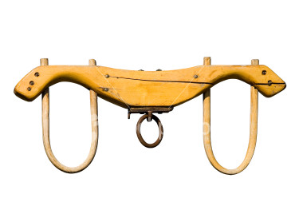
Does this sound like rest to you?

Slide 8
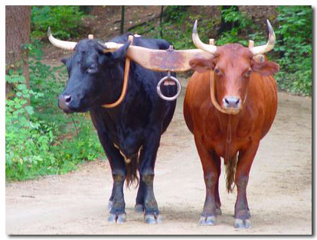
How to Lighten Your Load
GIVE UP CONTROL
“Cast your cares on the LORD and he will sustain you; He will never let the righteous fall.” Psalm 55:22

Slide 9
How to Lighten Your Load
GIVE UP CONTROL
Same place
+
Same pace

Slide 10
How to Lighten Your Load
LEARN TO TRUST
“learn from Me, for I am gentle
and lowly in heart”

Slide 11
How to Lighten Your Load
LEARN TO TRUST
“as the Father gave Me commandment, so I do.” John 14:30
“…I do nothing of Myself; but as My Father taught Me, I speak these things.” John 8:28

Slide 12
How to Lighten Your Load
LEARN TO TRUST
“A man's steps are of the LORD; how then can a man understand his own way?” Proverbs 20:24

Slide 13
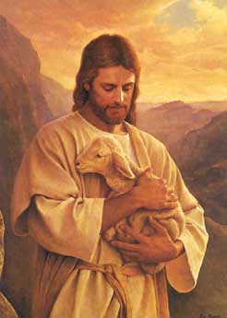
The Greatest Invitation Ever
“Come to Me, all you who labor and are heavy laden, and I will give you rest.“ Matthew 11:28

