Slide 1
Part 1: Fan or Follower?
October 23, 2011

Slide 3
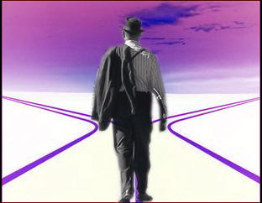

Slide 5
VIDEO HERE

Slide 7
Group 1: the “Jesus fish on the back of my car” group

Slide 8
Matthew 7:22-23
“Many will say to Me in that day, ‘Lord, Lord, have we not prophesied in Your name, cast out demons in Your name, and done many wonders in Your name?’ And then I will declare to them, ‘I never knew you; depart from Me, you who practice lawlessness!’”

Slide 9
Group 1: the “Jesus fish on the back of my car” group

Slide 10
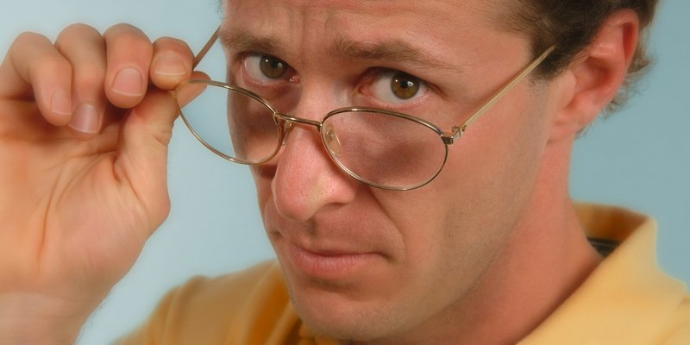
Group 1: the “Jesus fish on the back of my car” group
Group 2: the “why is there a fish on the back of my friend’s car” group

Slide 11
Where do YOU stand with Jesus?

Slide 12
Fan? Or Follower?

Slide 13
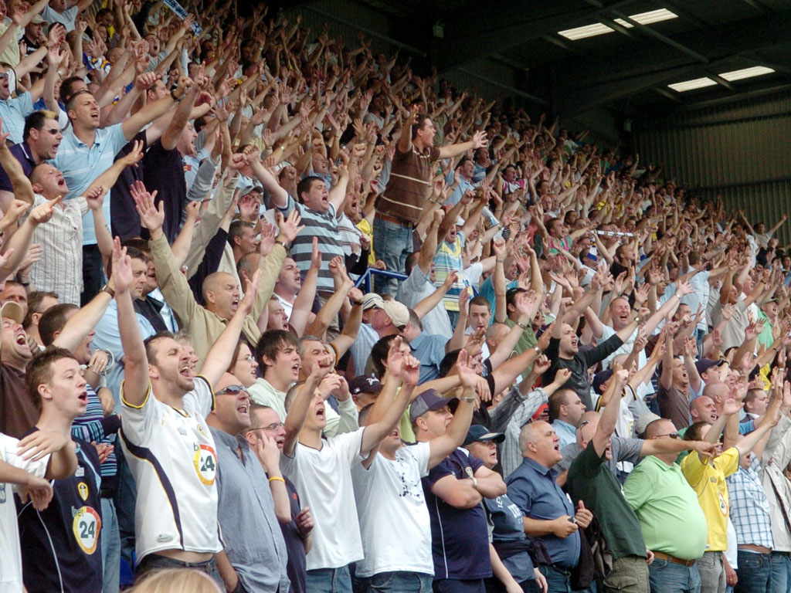
Fan? Or Follower?
Fan = “an enthusiastic admirer”

Slide 14
Luke 9:23
“Then He said to them all, “If anyone desires to come after Me, let him deny himself, and take up his cross daily, and follow Me.”

Slide 15
DTR with Jesus

Slide 16
DTR with Jesus
Why are you here?

Slide 17
DTR with Jesus
Why are you here?
“Then a great multitude followed Him, because they saw His signs which He performed on those who were diseased.” John 6:2

Slide 18
DTR with Jesus
Why are you here?
“From that time many of His disciples went back and walked with Him no more.” John 6:66

Slide 19
DTR with Jesus
Have you made it your own?

Slide 20
DTR with Jesus
Have you made it your own?
“If anyone comes to Me and does not hate his father and mother, wife and children, brothers and sisters, yes, and his own life also, he cannot be My disciple.” Luke 14:26

Slide 21
DTR with Jesus
Are you ALL in?

Slide 22
DTR with Jesus
Are you ALL in?
“So likewise, whoever of you does not forsake all that he has cannot be My disciple.” Luke 14:33

Slide 23
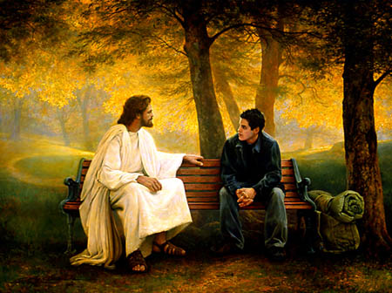
“But who do YOU say that I am?” Matthew 16:15

