Slide 1


Part 3: Turning Up the Heat at Zarephath
July 20, 2011
Part 1 - Title

Slide 2
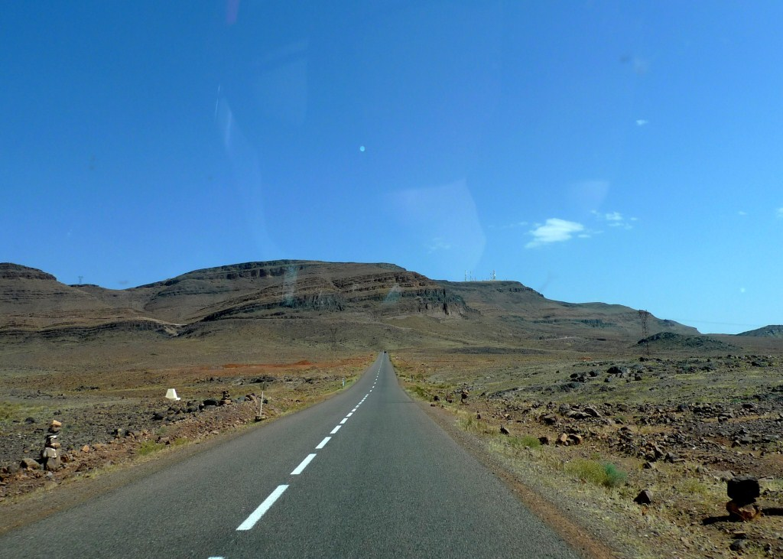
Road Trip to Zarephath
See 1 Kings 17:7-9

Slide 3
Road Trip to Zarephath
REMEMBER:
God doesn’t care about fixing the issue as much as He cares about fixing me

Slide 4
Three Commands for Elijah
“Arise, go to Zarephath, which belongs to Sidon, and dwell there. See, I have commanded a widow there to provide for you.” 1 Kings 17:9

Slide 5
Three Commands for Elijah
“Arise, go to Zarephath, which belongs to Sidon, and dwell there. See, I have commanded a widow there to provide for you.” 1 Kings 17:9

Slide 6
Three Commands for Elijah
“Arise, go to Zarephath, which belongs to Sidon, and dwell there. See, I have commanded a widow there to provide for you.” 1 Kings 17:9

Slide 7
Three Commands for Elijah
“Arise, go to Zarephath, which belongs to Sidon, and dwell there. See, I have commanded a widow there to provide for you.” 1 Kings 17:9

Slide 8
Three Commands for Elijah
“Arise, go to Zarephath, which belongs to Sidon, and dwell there. See, I have commanded a widow there to provide for you.” 1 Kings 17:9

Slide 9
Three Commands for Elijah
“No temptation has overtaken you except such as is common to man; but God is faithful, who will not allow you to be tempted beyond what you are able, but with the temptation will also make the way of escape, that you may be able to bear it.” 1 Corinthians 10:13

Slide 10

Complaining about what God commands stops us from receiving what God promises.

Slide 11
The Furnace Gets Hotter
See 1 Kings 17:10-12

Slide 12

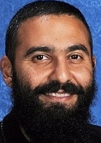
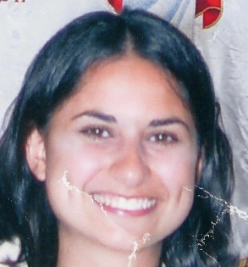
What I Expected

Slide 13
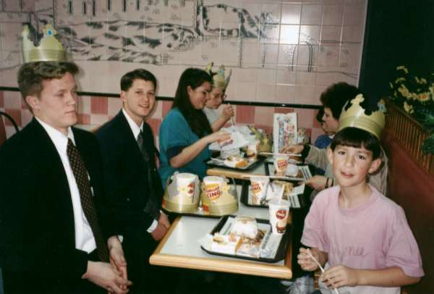
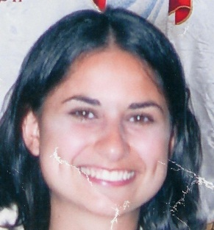
What I Got

Slide 14
Elijah at a dead end???

Slide 15
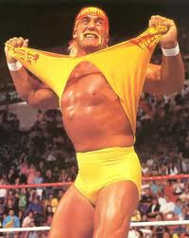
Elijah at a dead end???
THAT’S WHAT YOU THINK!
See 1 Kings 17:13-16

Slide 16
Lessons from Zarephath

Slide 17
Lessons from Zarephath
God’s leading is surprising; don’t analyze.

Slide 18
Lessons from Zarephath
God’s leading is surprising; don’t analyze.
God’s 1st step is often hardest; don’t quit.

Slide 19
Lessons from Zarephath
God’s leading is surprising; don’t analyze.
God’s 1st step is often hardest; don’t quit.
God’s promises needs obedience; don’t ignore your part.

Slide 20
Lessons from Zarephath
God’s leading is surprising; don’t analyze.
God’s 1st step is often hardest; don’t quit.
God’s promises needs obedience; don’t ignore your part.
God’s provision is always enough; don’t you forget it!

Slide 21
2 Chronicles 16:9
“For the eyes of the LORD run to and fro throughout the whole earth, to show Himself strong on behalf of those whose heart is loyal to Him.”

