Slide 1
And the Walls Came Tumbling Down
Book of Esther – Part 8
October 6, 2010

Slide 2
“Oh, the depth of the riches both of the wisdom and knowledge of God! How unsearchable are His judgments and His ways past finding out!”
Romans 11:33

Slide 3
“Oh, the depth of the riches both of the wisdom and knowledge of God! How unsearchable are His judgments and His ways past finding out!”
Romans 11:33

Slide 4
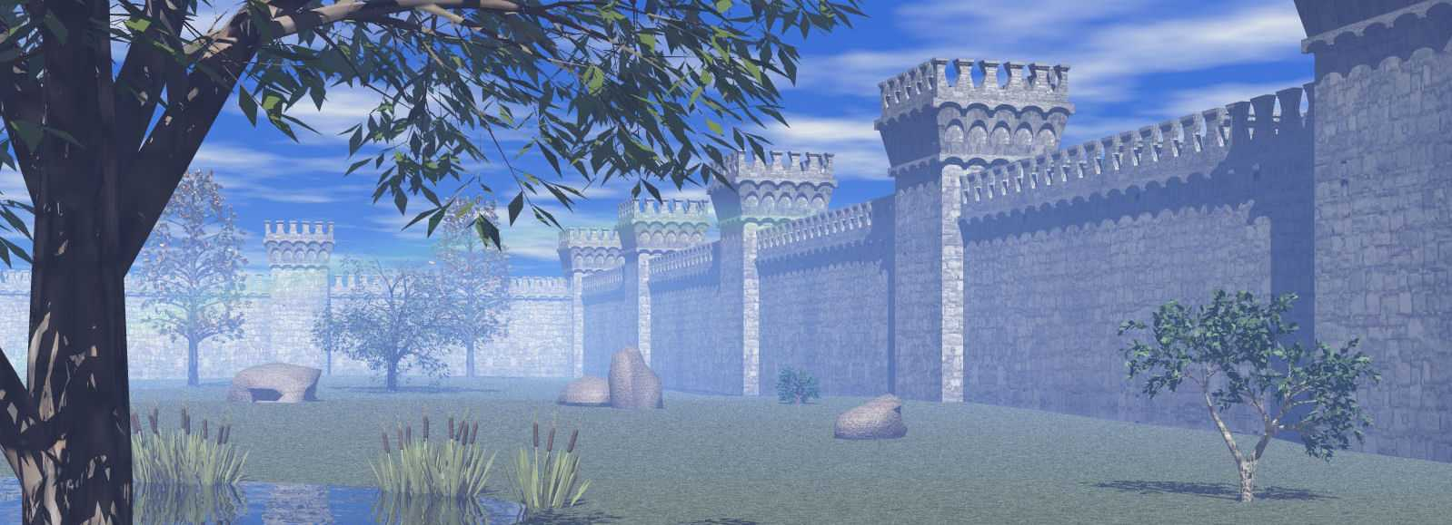
The Final Wall

Slide 5
The Final Wall
“So the people shouted when the priests blew the trumpets. And it happened when the people heard the sound of the trumpet, and the people shouted with a great shout, that the wall fell down flat. Then the people went up into the city, every man straight before him, and they took the city.” Joshua 6:20

Slide 6
The Final Wall
See Esther 8

Slide 7
The Final Wall
Lesson 1: Beware of foolish DECISIONS – they will outlive you.

Slide 8
The Final Wall
Lesson 1: Beware of foolish DECISIONS – they will outlive you.
Lesson 2: Beware even more so of foolish SYSTEMS that enable you to make foolish decisions.

Slide 9
The Final Wall
“For as the heavens are higher than the earth, so are My ways higher than your ways, and My thoughts than your thoughts.” Isaiah 55:9

Slide 10
Big Walls vs Big God
The task ahead of us is never as
great as the power behind us

Slide 11
Big Walls vs Big God
The task ahead of us is never as
great as the power behind us
“Now to Him who is able to do exceedingly abundantly above all that we ask or think, according to the power that works in us” Ephesians 3:20

Slide 12
Big Walls vs Big God
“I blessed the Most High and praised and honored Him who lives forever: For His dominion is an everlasting dominion, and His kingdom is from generation to generation. All the inhabitants of the earth are reputed as nothing; He does according to His will in the army of heaven and among the inhabitants of the earth. No one can restrain His hand or say to Him, “What have You done?” Daniel 4:34-35

Slide 13
“Weeping may endure for a night, but joy comes in the morning.” Psalm 30:5

Slide 14
“Weeping may endure for a night, but joy comes in the morning.” Psalm 30:5

