Slide 1
The Sweetness of God’s Sovereignty
Book of Esther – Part 7
September 29, 2010

Slide 2
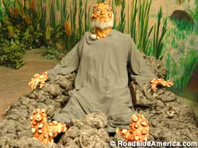

Slide 3
Job 3:1-3, 11
“After this Job opened his mouth and cursed the day of his birth. And Job spoke, and said: ‘May the day perish on which I was born, and the night in which it was said, ‘A male child is conceived.’…Why did I not die at birth? Why did I not perish when I came from the womb?”

Slide 4
Job 3:24-26
“For my sighing comes before I eat, and my groanings pour out like water. For the thing I greatly feared has come upon me, and what I dreaded has happened to me. I am not at ease, nor am I quiet; I have no rest, for trouble comes.”

Slide 5

Understanding God’s Timing

Slide 6
Understanding God’s Timing
“And we know that all things work together for good to those who love God, to those who are the called according to His purpose.” Romans 8:28

Slide 7
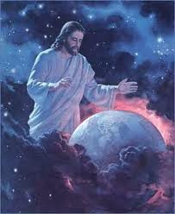
God Working in Silence

Slide 8
God Working in Silence
“And the word of the LORD was rare in those days; there was no widespread revelation.” 1 Samuel 3:1

Slide 9
God Working in Silence
“And the word of the LORD was rare in those days; there was no widespread revelation.” 1 Samuel 3:1
The turning points of life are
often very subtle

Slide 10
God Working in Silence
See Esther 7

Slide 11
God Working in Silence
“If you see the oppression of the poor, and the violent perversion of justice and righteousness in a province, do not marvel at the matter; for high official watches over high official, and higher officials are over them.” Ecclesiastes 5:8

Slide 12

The Sweetness of God’s Sovereignty

Slide 13
The Sweetness of God’s Sovereignty
What appears as the end of the world often ends up being the beginning of life

