Slide 1
The Making of a Persian Beauty Queen
Book of Esther – Part 2
August 25, 2010

Slide 2
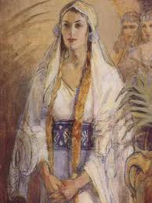
Fall in love with Esther
Grow in zeal for Word of God
Realize and trust in power of the Invisible Hand of God

Slide 3
God’s Hand: both Invincible & Invisible
“…and let the king give her royal position to another who is better than she.”
Esther 1:19

Slide 4
Here she comes…MISS PERSIA!
See Esther 2:1-4

Slide 5
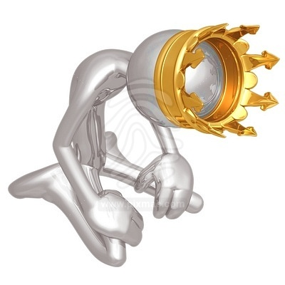
Here she comes…MISS PERSIA!

Slide 6
Lesson from a Foolish King

Slide 7
Lesson from a Foolish King
Beware of rash decisions
“The plans of the diligent lead surely to plenty, but those of everyone who is hasty, surely to poverty.” Proverbs 21:5

Slide 8
Lesson from a Foolish King
Beware of rash decisions
“Husbands, likewise, dwell with them with understanding, giving honor to the wife, as to the weaker vessel, and as being heirs together of the grace of life, that your prayers may not be hindered.” 1 Peter 3:7

Slide 9
Lesson from a Foolish King
Beware of rash decisions
“And the LORD God said, “It is not good that man should be alone; I will make him a helper comparable to him.” Genesis 2:18

Slide 10
The Queen to be…
See Esther 2:5-9

Slide 11
The Queen to be…
See Esther 2:5-9
“beautiful in form and lovely to look at”

Slide 12
Lesson from an orphaned Jewish girl

Slide 13
Lesson from an orphaned Jewish girl
No one is beyond the reach of God’s Hand

Slide 14
Lesson from an orphaned Jewish girl
No one is beyond the reach of God’s Hand
So stop complaining;
trust in God’s Invisible Hand
“Do all things without complaining and disputing” Philippians 2:14

Slide 15
And the winner is…
See Esther 2:10-18

Slide 16
Lesson from a Beauty Queen

Slide 17
Lesson from a Beauty Queen
True beauty comes from character,
not cosmetics.

Slide 18
Lesson from a Beauty Queen
True beauty comes from character,
not cosmetics.
“And at the end of ten days their features appeared better and fatter in flesh than all the young men who ate the portion of the king’s delicacies.” Daniel 1:15

Slide 19
Lesson from a Beauty Queen
True beauty comes from character,
not cosmetics.
“Then the king interviewed them, and among them all none was found like Daniel, Hananiah, Mishael, and Azariah; therefore they served before the king…

Slide 20
Lesson from a Beauty Queen
True beauty comes from character,
not cosmetics.
…And in all matters of wisdom and understanding about which the king examined them, he found them ten times better than all the magicians and astrologers who were in all his realm.” Daniel 1:19-20

