Slide 1
The Invisible Hand of God
Book of Esther – Part 1
August 18, 2010

Slide 2
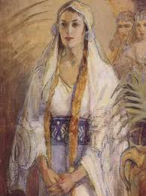
“She is clothed with strength and dignity; she can laugh at the days to come.” Proverbs 31:25

Slide 3
Fall in love with Esther
“She is clothed with strength and dignity; she can laugh at the days to come.” Proverbs 31:25

Slide 4
Fall in love with Esther
Grow in zeal for Word of God
“She is clothed with strength and dignity; she can laugh at the days to come.” Proverbs 31:25

Slide 5
Fall in love with Esther
Grow in zeal for Word of God
Realize and trust in power of the Invisible Hand of God
“She is clothed with strength and dignity; she can laugh at the days to come.” Proverbs 31:25

Slide 6
Immortal, invisible, God only wise,
In light inaccessible hid from our eyes,
Most blessed, most glorious, the Ancient of Days,
Almighty, victorious – Thy great Name we praise.
Unresting, unhasting, and silent as light,
Nor wanting, nor wasting, Thou rulest in might;
Thy justice, like mountains, high soaring above
Thy clouds, which are fountains of goodness & love

Slide 7
Lesson of Esther
God’s Hand is both Invincible & Invisible

Slide 8
Lesson of Esther
God’s Hand is both Invincible & Invisible
God’s silence ≠ God’s absence

Slide 9
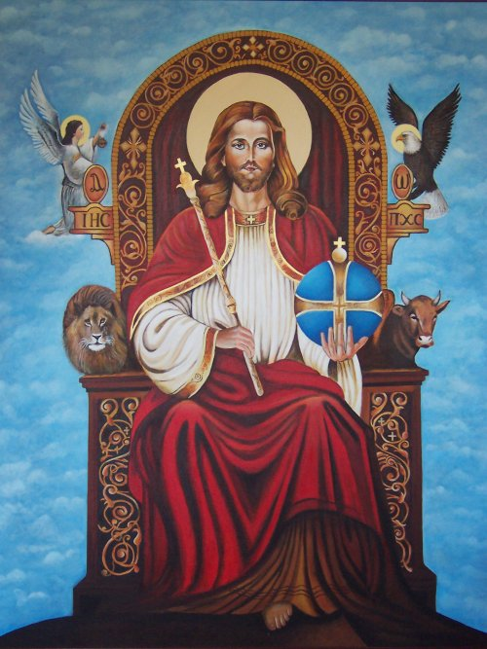
God is in FULL CONTROL

Slide 10
God is in FULL CONTROL
See Daniel 4

Slide 11
God is in FULL CONTROL
providentia
pro = before, ahead of time
videre = to see

Slide 12
So what about Esther?

Slide 13
So what about Esther?
“But though the name of God be not in it [Esther], the finger of God is directing many minute events for the bringing about of his people’s deliverance.”
Matthew Henry

Slide 14
So what about Esther?
King Ahasuerus [Xerxes]
  ay-HAS-eeoo-HER-uhs
Queen Vashti
Wicked Haman
Uncle Mordecai
Esther [‘star’]

Slide 15
Uneventful beginnings…incredible endings
See Esther 1

Slide 16
Uneventful beginnings…incredible endings
“And we know that all things work together for good to those who love God”
Romans 8:28

Slide 17
Invisible Hand of God never rests
“He will not let your foot slip—he who watches over you will not slumber; indeed, he who watches over Israel will neither slumber nor sleep. The LORD watches over you—the LORD is your shade at your right hand; the sun will not harm you by day, nor the moon by night. The LORD will keep you from all harm—he will watch over your life; the LORD will watch over your coming and going both now and forevermore.” Psalm 121

Slide 18
Invisible Hand of God never rests
“If you see the oppression of the poor, and the violent perversion of justice and righteousness in a province, do not marvel at the matter; for high official watches over high official, and higher officials are over them.” Ecclesiastes 5:8

