Slide 1
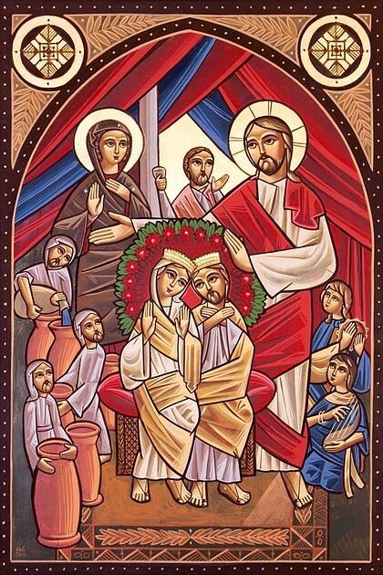
Schedule
St. Mark Marriage Retreat 2022
Talk 1: Fighting and Forgiving
Talk 2: Marriage as Salvation
Talk 3: Letting Christ in to heal the Marriage
Talk 4: Children as a means to Salvation

Slide 2
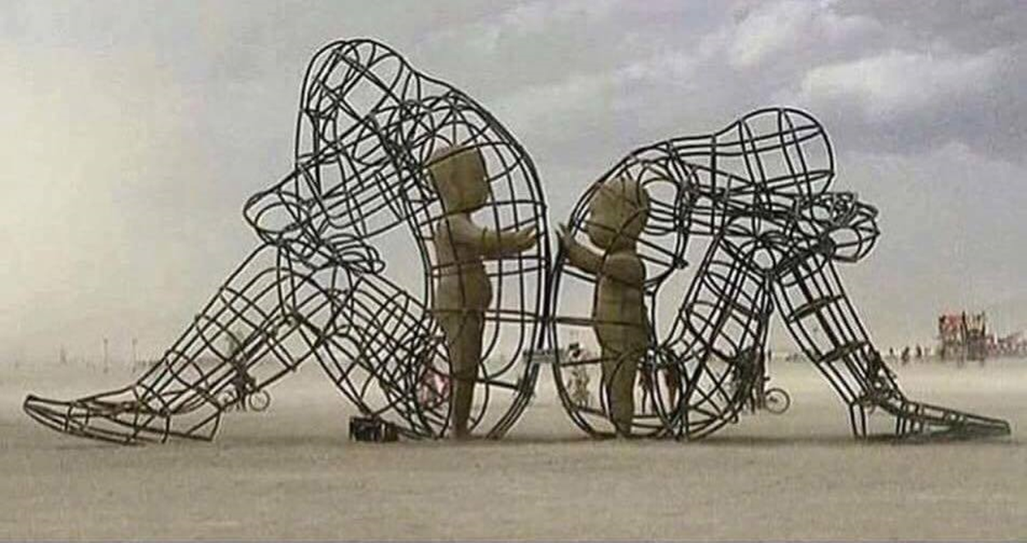
Talk 1:
Fighting and Forgiving

Slide 3
Was asked by Nancy and Abouna, not sure why
Many offered me sources of “material”…
My qualifications:
  I’m an accountant
  I have a PhD in accounting
  I don’t have a degree in child psychology
  I don’t have a degree in marriage therapy or psychology or sociology or child behavior
  I don’t have grandkids or even a good track record with my own kids…

Slide 4
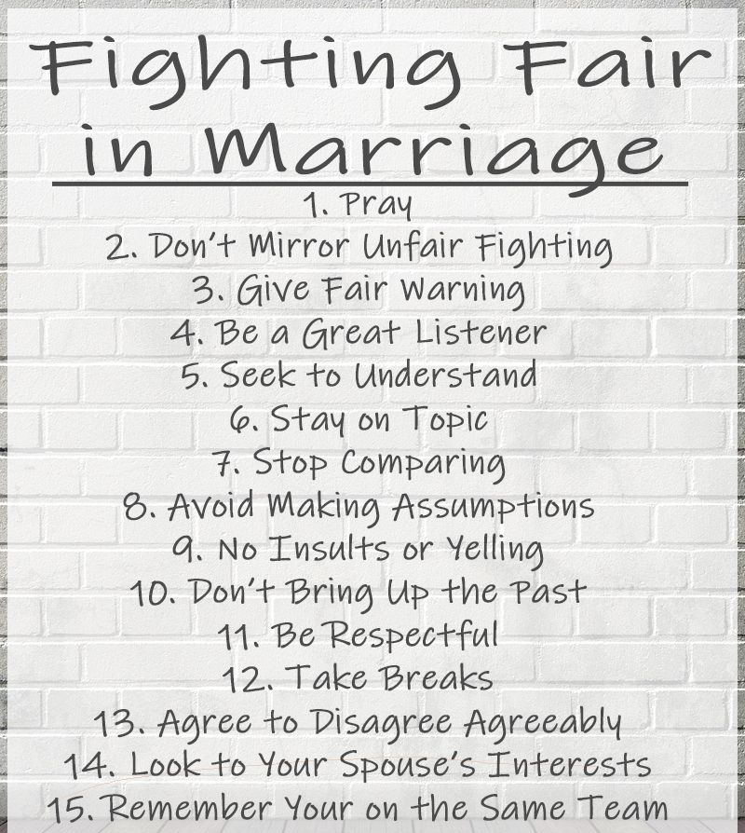
Tips on how to fight….
You’re

Slide 5
Forgiveness of Others…
How can someone forgive and forget? This is starting all things anew.
One thing that God creates in us is the ability to forgive. This is not something natural and it's not something human.
We say this in the Lords prayer all the time. But when it’s real, it doesn't come out of your mouth nearly as easy….
This is a spiritual endeavor...

Slide 6
Forgiveness of Others
“Each person must bear the weaknesses of others. Who is perfect? Who can boast that he has kept his heart undefiled? Hence, we are all sick, and whoever condemns his brother does not perceive that he himself is sick, because a sick person does not condemn another sick person.” –
---Elder Ephraim of Saint Anthony's monastery

Slide 7
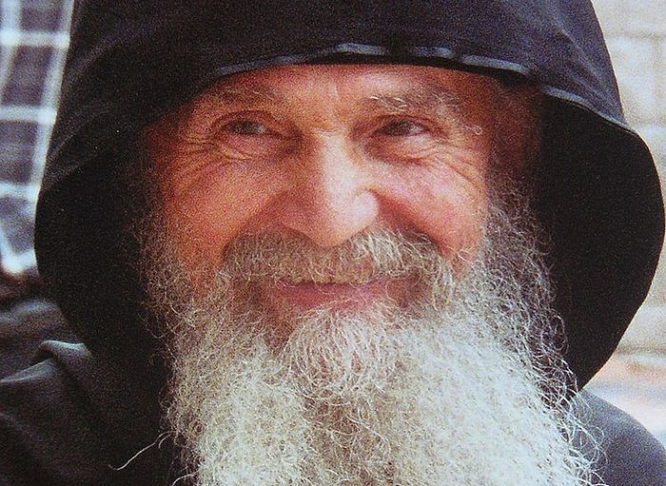
Forgiveness of Others
“Each person must bear the weaknesses of others. Who is perfect? Who can boast that he has kept his heart undefiled? Hence, we are all sick, and whoever condemns his brother does not perceive that he himself is sick, because a sick person does not condemn another sick person.” –
---Elder Ephraim of Saint Anthony's monastery

Slide 8
Why is it hard to forgive?
1) Someone is harsh and hurts you…
Cruelty, meanness, harshness, and real consequences make it very hard.
Imagine someone put in jail for 10 years over a lie. The consequences are real!
What were Joseph’s feelings? He was in a pit and then prison. How did he remember his brothers? They kept him from his father - all over a colorful coat? Can you even ask Joseph to forgive in the middle of the story??

Slide 9
Why is it hard to forgive?
2) Mistakes repeat themselves…
When someone continues to sin against you over and over, it makes it more difficult.
They don’t realize -- notice -- care -- and just continues to hurt you without any sensitivity towards your own feelings, this makes it tough.
It’s a permanent jury. Lost finger -- hand -- eye -- money. Every time you see it, the injury repeats. Satan is very clever here to keep reminding you…

Slide 10
Why is it hard to forgive?
3) People don’t admit their mistake…
It’s one thing to admit they are wrong and ask for your forgiveness, it's easy and it pacifies us. But sometimes they insist that they are right and argue.
We do not see the repentance with our own eyes. We don't see God's judgment or intervention. They are successful, making money, their children are doing well, etc...
Psalm 37:7 “do not fret when people succeed in their ways, when they carry out their wicked schemes. Refrain from anger and turn from wrath; do not fret—it leads only to evil.”

Slide 11
Why is it hard to forgive?
4) It’s someone you love…
When you expect love it’s harder. i.e., Christ was betrayed by Judas
An enemy or someone you don't know is not nearly as painful as it is from someone you love.

Slide 12
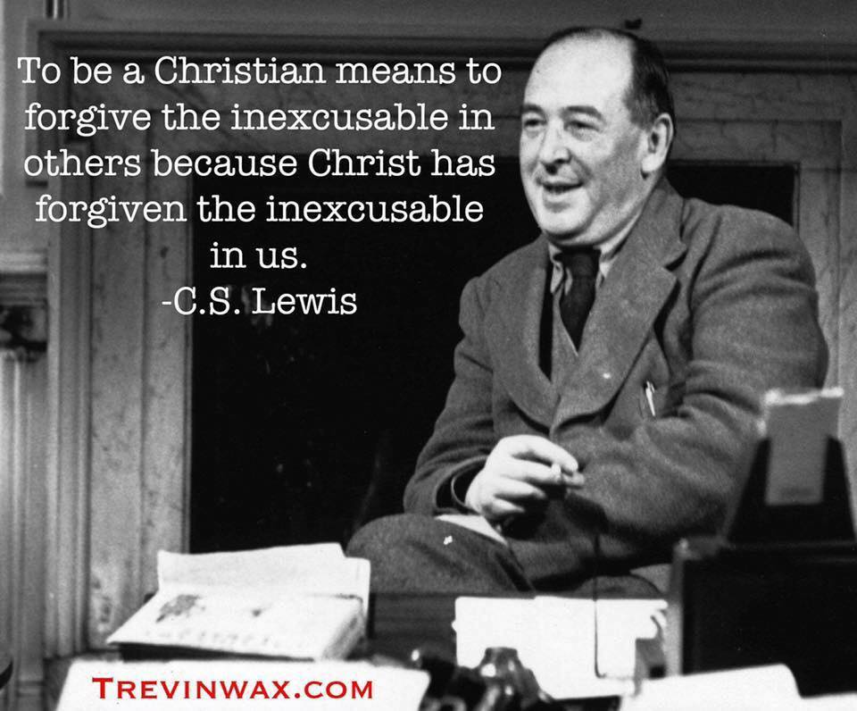

Slide 13
From Psychology: distortions that trigger and interact with anger.
Significant intrusion: The angry individual perceives some one has intruded on them or something they love.
Selective focusing: disregarding some nice things someone has done while centering on an error they made.

Slide 14
From Psychology….
Mind-reading: concluding, without proof, the reason for someone’s improper action was to "get at" the angry person and/or was directed to the person;
Fortune telling: predicting only unseemly things will happen to you and this will continue in the future;
Catastrophizing: evaluating the errors, improper actions and unseemly behaviors of others as more that 100% bad. These distortions enable the individual to create ongoing irrational mental scenarios that fuel the anger emotion.

Slide 15
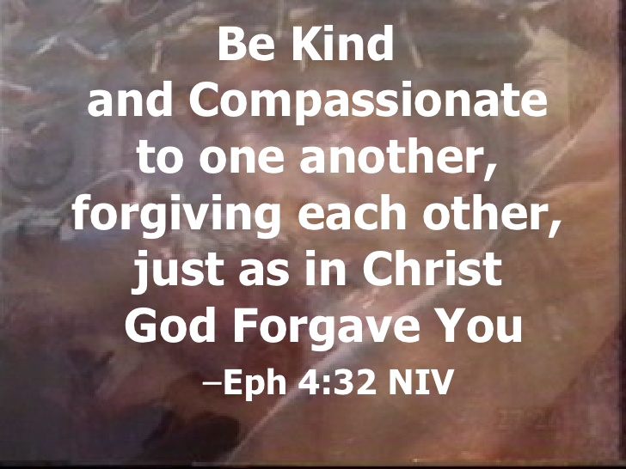
“There is nothing colder than a Christian who is not concerned about the salvation of others . . . Do not say, I cannot help others: for, if you are truly a Christian it is impossible not to."
--St. John Chrysostom
Forgiving Each Other…

Slide 16
Consequences of not forgiving others…
Anxiety….
Common problem for modern era – why so many anti-anxiety drugs?
Story of young man realized why he was sinning extensively – angry at his dad.
Once you give Satan a stronghold in your life, it leads to all the problems of sin...

Slide 17
Consequences of not forgiving others…
Fear.
When you don’t forgive, fear enters your life.
Fear without reason. You have given yourself over to evil, and one of the consequences of evil is fear. You may not have forgiven your parents, your siblings, your coworkers, your wife and this will create fear.
It will also create relationships that aren't very passionate or deep. Either with God or other people.

Slide 18
Consequences of not forgiving others…
Disliking yourself.
You also find that people seem to hate themselves. Feeling of non-forgiveness and evil inside you makes you feel ugly and may make you think God doesn't love you either or that people do not. Because there is a darkness inside you that you yourself don’t want to be there.
All this is a summary of basically saying why it is very difficult to forgive, but it is also very dangerous not to forgive.

Slide 19

Things to look out for…
Note: denial is not forgiveness - you are simply repressing your memory.
  And it will come out again is that person does anything else. You'll explode like a volcano. This is a defense mechanism and simply bottling things up it's not forgiveness either.
We chose not to deal with it and ignore it. Extremely Common… ☹

Slide 20
Things to look out for…
Smile at each other even though we can't stand each other. No forgiveness. This is very dangerous and the church says we cannot take communion in this state!
You may not realize that you haven't forgiven.
You can see it when there is a small infraction by someone and all of the old feelings come out in a huge argument. It's like there's a dark room inside that you just don't go to. This is darkness and leaves a place in you like a big dark hole, terror, darkness…

Slide 21
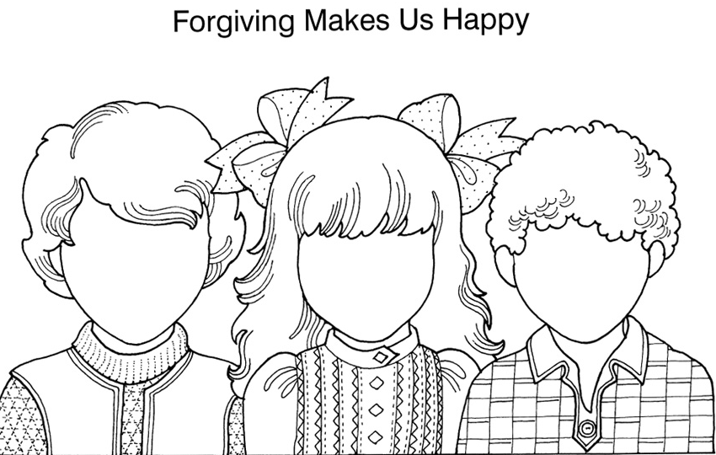

Slide 22
HOW do we forgive??
So what is the solution? How do we forgive? There is a story of a woman in Egypt who son was murdered by ISIS…
Christ said in Matthew 18 Peter asked how many times should we forgive? Peter went up to 7, even though he probably can't even do it once!
What did I say? 7×70. What is the point? Don't count!
Peter is looking at OT approach of Justification, Christ is showing him a new way.
What is the real point behind what Christ said??
Telling us about who God is… And are we in His image??

Slide 23
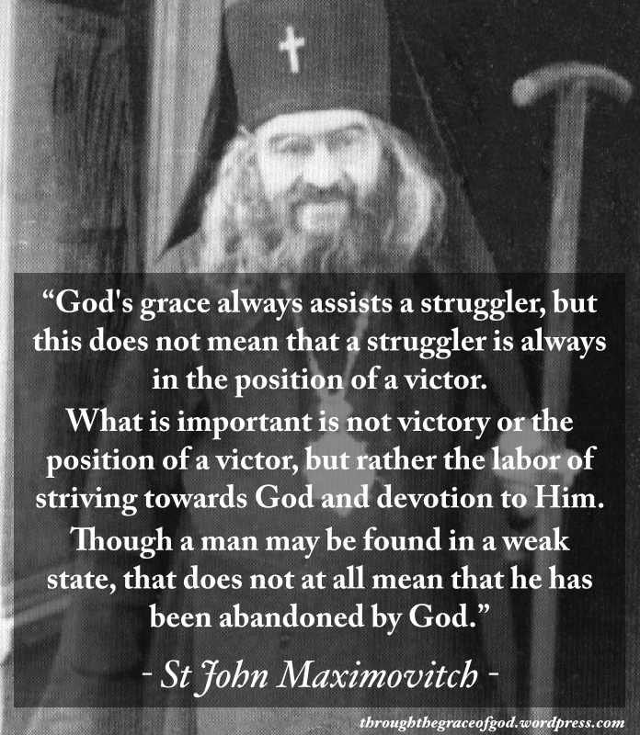
HOW do we forgive??

Slide 24
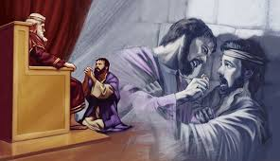
Matthew 18: After Christ told Peter to forgive, 7x70 times, he told this Parable…
Servant is forgiven 500 denari by master
Then refuses to forgive 50 denari to another servant
Master finds out then holds servant responsible for 500 again…

Slide 25
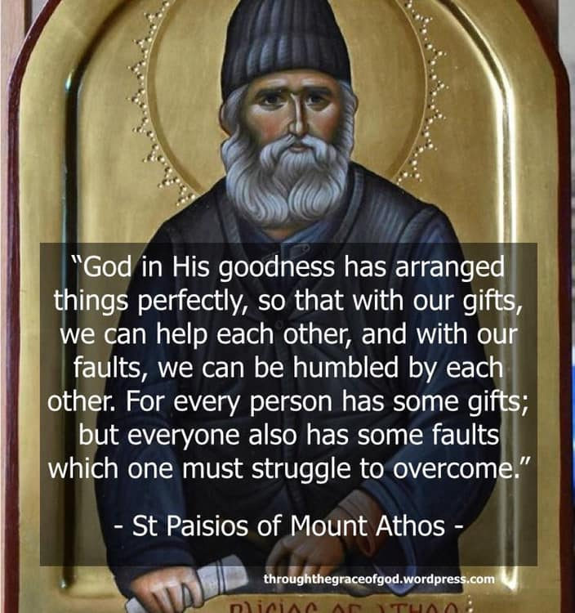

Slide 26
HOW do I not just forget it, but actually love the person?
Connection with Christ. It is impossible to forgive unless you are connected - it cannot happen. Someone hurts your children, or judged you, or humiliated you. The solution is to dissolve into Christ. It is his strength and not yours.
When you are connected to Christ, you are satisfied and filled. Proverbs 27:7 says, "One who is full loathes honey from the comb, but to the hungry even what is bitter tastes sweet.”
The closer you are, the smaller issue becomes. And the more filled you are, the more you forgive. As soon as you leave Christ for even a moment, you will hate you will get revenge you will go on the offensive and attack.

Slide 27
Where does the Connection come from??
“In your light, we shall see light” So this means it is a lot of prayer, it is a lot of communion, is a lot of meditation, it is a lot of prostrations. You must forget the world as if you died to the world and live with Christ.
Christ also said, forgive me as I forgive others. So another solution, is to remind yourself of Christ's words. Look at what you have you done against God. If you are honest, you will see that it is greater. How many times have we stolen from God how many times have we betrayed him, hurt him, and not reciprocated his love?

Slide 28
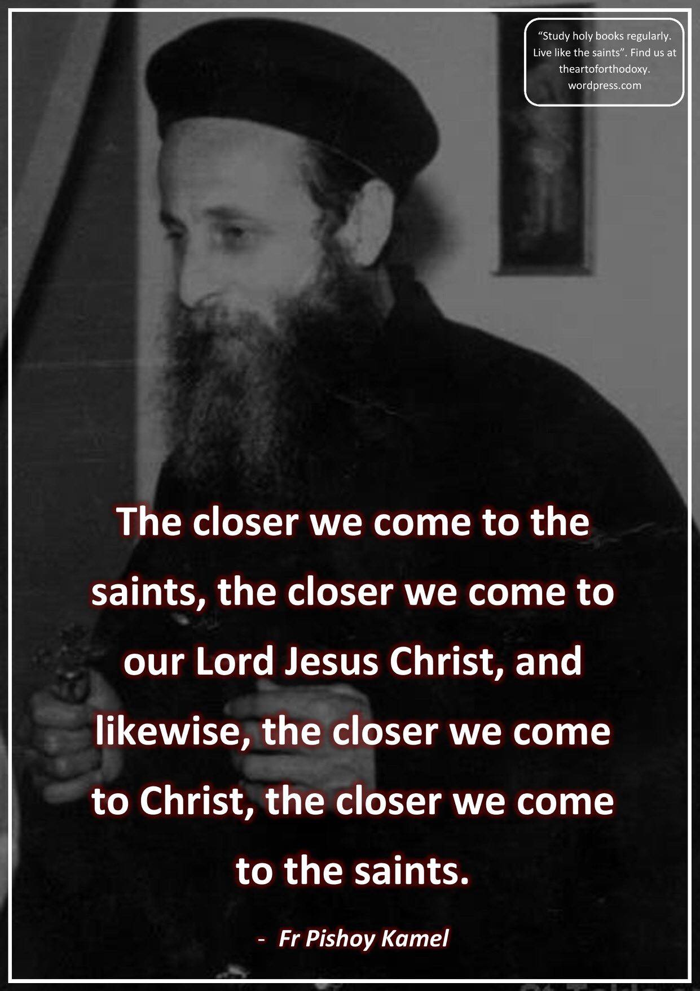

Slide 29
HOW do we forgive??
David forgave Absalom his son, Abaseer his advisor, King Saul who tried to kill him. Why? Because he always had feelings of repentance over his own sins. Always remember testing, by being repentant it helped him to forgive others.
This is one of the biggest trials in our lives and one that leads us to paradise. Think of it as a test if you want to pass and get 100% on!

Slide 30
HOW do I not just forget it, but actually love the person?
Think about forgiveness. Don’t think about the person. Think that God allowed this for a reason. Focus on that. Nice story about David…

Slide 31
HOW do I not just forget it, but actually love the person?
Think about forgiveness. Don’t think about the person. Think that God allowed this for a reason. Focus on that. Nice story about David…
Think about Heaven. Don’t value the world. If you realize that you haven’t lost heaven, it makes it all better. Nice story from St. Stephen…

Slide 32
HOW do I not just forget it, but actually love the person?
Think about forgiveness. Don’t think about the person. Think that God allowed this for a reason. Focus on that. Nice story about David…
Think about Heaven. Don’t value the world. If you realize that you haven’t lost heaven, it makes it all better. Nice story from St. Stephen…
Think about Your sins. “To whom little is forgiven, the same loves little”. Let me replace that with ‘forgives’ little..

Slide 33
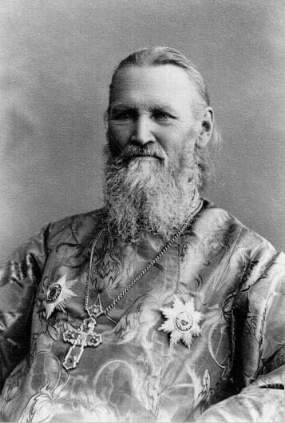
Who is the real enemy??
“The Devil cunningly induces us – instead of irritating us against himself – to notice our neighbors’ sins, to make us spiteful and angry with others, and to awaken our contempt towards them, thus keeping us in enmity with our neighbors, and with the Lord God Himself. Therefore, we must despise the sins, the faults themselves, and not our brother who commits them at the Devil’s instigation, through infirmity and habit; we must pity him, and gently and lovingly instruct him,as one who forgets himself, or who is sick, as a prisoner and the slave of his sin. But our animosity, our anger towards the sinner only increases his sickness, oblivion, and spiritual bondage, instead of lessening them.”
---St. John of Kronstadt, My Life in Christ

Slide 34
“Love demands discretion, and discretion, in turn, is an art. If you are unfamiliar with the art of love, then you do not know how to love. Love overlooks the flaws of our brother. It forgives mistakes. It tolerates bad habits. It gives way to obstinacy. It avoids criticism. It is oblivious to sarcasm. It disperses suspicions. It does not accept slander. It does not pass judgment or debase others publicly. It covers all shortcomings in a polite and brave manner. “Love suffers long and is kind; love does not envy; love does not parade itself, is not puffed up; does not behave rudely, does not seek its own, is not provoked, thinks no evil” (1 Cor. 13:4-6), thunders the Apostle Paul. Love, through its simplicity and sincerity, is unaware of evil. It is crystal clear like water from a pristine lake. No fierce wave of evil or deceit can disturb it. The person who loves is the greatest victor in the spiritual battle. He wins using a smile and kindness.”
– ‘Art of Salvation’ Elder Ephraim

Slide 35
In Summary…
Christ Forgave me
I am in the Image of Christ and strive to be like Christ
Then I must forgive in the same way
“Loving one's enemies does not mean loving wickedness, theft, ungodliness, or adultery.
Rather, it means loving the thief, the ungodly person, and the adulterer. Not as far as he sins, but as he is a man and is the work of God.” --- St. Clement of Alexandria

