Slide 1
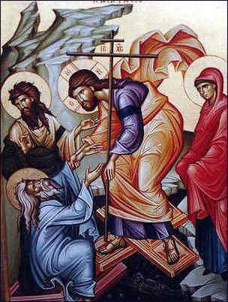
The Resurrected Mind
Light & Life
Holy 50 Days

Slide 2
What makes a resurrected mind?
1 If then you were raised with Christ, seek those things which are above, where Christ is, sitting at the right hand of God. 2 Set your mind on things above, not on things on the earth. 3 For you died, and your life is hidden with Christ in God. 4 When Christ who is our life appears, then you also will appear with Him in glory.5 Therefore put to death your members which are on the earth: Col: 3:1-5

Slide 3
Resurrected Mind
Mind that is raised up-
Not dwelling on death but anticipating new life
Not rooted and grounded in this world, but ascended up to the heavens.
Putting to death so that there might be a resurrection

Slide 4
Pilgrims
1 Peter, an apostle of Jesus Christ, To the pilgrims 1 Pet 1:1
Those who go on a religious journey for spiritual gains
Someone who is passing through but plans on returning home

Slide 5
Pilgrims
America is not your final destination!
20 For our citizenship is in heaven, from which we also eagerly wait for the Savior, the Lord Jesus Christ Phil 3:20

Slide 6
Pilgrims
Tent life- Here one day, ready to move the next.
- Not building deep foundations on earth but rather
Jesus Christ is our foundation and the chief cornerstone

Slide 7
Pilgrims
Mindset of “going home”
For I am hard-pressed between the two, having a desire to depart and be with Christ, Phil 1:23

Slide 8
Pilgrims
When in Rome, don’t do as the Romans do! Do as heavenly citizens do.
11 Beloved, I beg you as sojourners and pilgrims, abstain from fleshly lusts which war against the soul, 12 having your conduct honorable among the Gentiles, that when they speak against you as evildoers, they may, by your good works which they observe, glorify God in the day of visitation.
1 Pet 2:11

Slide 9
A resurrected mind
Is more concerned about the incorruptible than the corruptible

Slide 10
The Corruptible
      Things that lose their original beauty or decrease in value or change in a drastic way for the worse. They become defiled, spoiled or fade away.
      Has limited life span

Slide 11
The corruptible
What things are corruptible ?
  Gold and silver
    knowing that you were not redeemed with corruptible things, like silver or gold, 1 Pet 1:18
    that the genuineness of your faith, being much more precious than gold that perishes, 1 Pet 1:7

Slide 12


Slide 13
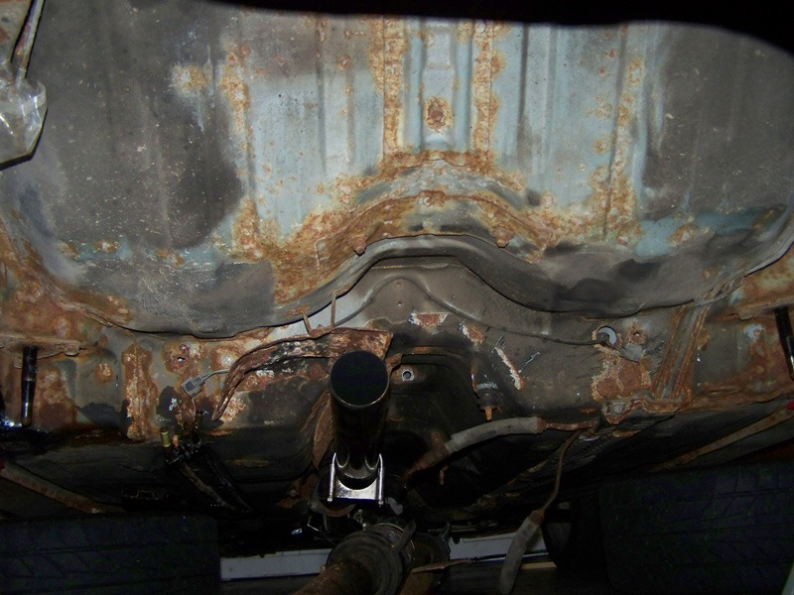

Slide 14
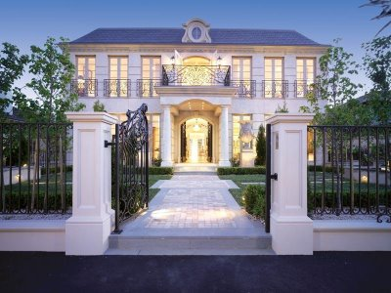

Slide 15


Slide 16
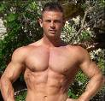

Slide 17
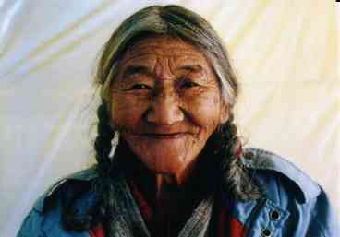

Slide 18
Corruptible
Most beautiful cars
Luxury homes
Great bodies
Gourmet foods
Stock Portfolios
I phones

Slide 19
The Incorruptible
Value never decreases, beauty never fades, does not spoil,
Is eternal!

Slide 20
The Incorruptible
an inheritance incorruptible and undefiled and that does not fade away, reserved in heaven for you 1 Peter 1:4
having been born again, not of corruptible seed but incorruptible, through the word of God which lives and abides forever 1 Pet 1:23

Slide 21
The Incorruptible
Do not let your adornment be merely outward—arranging the hair, wearing gold, or putting on fine apparel— 4 rather let it be the hidden person of the heart, with the incorruptible beauty of a gentle and quiet spirit, which is very precious in the sight of God. 1 Pet 3:3-4
and when the Chief Shepherd appears, you will receive the crown of glory that does not fade away. 1 Peter 5:4

Slide 22
Fiery Trial
A resurrected mind accepts and endures suffering- As if going through fire to be made more pure
  In this you greatly rejoice, though now for a little while, if need be, you have been grieved by various trials, 7 that the genuineness of your faith, being much more precious than gold that perishes, though it is tested by fire, may be found to praise, honor, and glory at the revelation of Jesus Christ, 1 Pet 1:6-7

Slide 23
Fiery Trial
The goal of the pilgrimage- to return having burned off those things that are impure, and acquired a beauty through virtues so that we could be presented to Christ as glorious
It is part of the process

Slide 24
Resurrected mind endures suffering
Because is has hope, a living hope.
Blessed be the God and Father of our Lord Jesus Christ, who according to His abundant mercy has begotten us again to a living hope through the resurrection of Jesus Christ from the dead, 4 to an inheritance incorruptible and undefiled and that does not fade away, reserved in heaven for you, 5 who are kept by the power of God through faith for salvation ready to be revealed in the last time. 1 Pet 3:3-5

Slide 25
Resurrected mind endures suffering
Because suffering precedes eternal glory
Beloved, do not think it strange concerning the fiery trial which is to try you, as though some strange thing happened to you; 13 but rejoice to the extent that you partake of Christ’s sufferings, that when His glory is revealed, you may also be glad with exceeding joy. 1 Pet 4:12-13

Slide 26
Resurrected mind values the precious
Christ is the Precious- Mentioned 6 times
Christ is the precious one to those who believe 1 Pet 2:7
We were redeemed by his precious blood 1 Pet 1:19
We have become precious to Him

Slide 27
Resurrected Mind
But sanctify the Lord God in your hearts and always be ready to give a defense to everyone who asks you a reason for the hope that is in you, with meekness and fear. 1 Peter 3:15

